Slide 1

Welcome to Learn
Using Group Codes in Learn as an Instructor

Slide 2
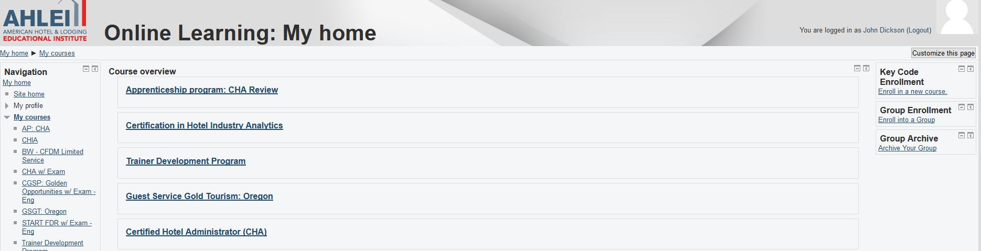
Creating a Group (Instructor Only)
Please go to your URL bar and type in learn.ahlei.org.

Slide 3

Creating a Group (Instructor Only)
Once on Learn, please select the “Keycode Enrollment” option on the top right hand side of the screen.

Slide 4
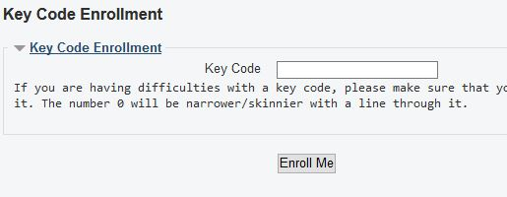
Creating a Group (Instructor Only)
Now in the “Keycode Enrollment” area, you will enter in the keycode and click on “Enroll Me”.
This step enrolls you as the instructor into the class which creates the group that the students can now join. Please continue on to show how the students will now enroll into the group.

Slide 5
Sharing with Students
We strongly recommend sharing the Group Key with students SEPARATELY from their Key Code to avoid confusion.
The Key Code: Allows students to access and take the exam
Group Code: Allows the student to “enroll” in your cohort so that you, their instructor, may see their exam results.
***Students MUST enter the group code or you will not be able to see their exam scores.

