Slide 1
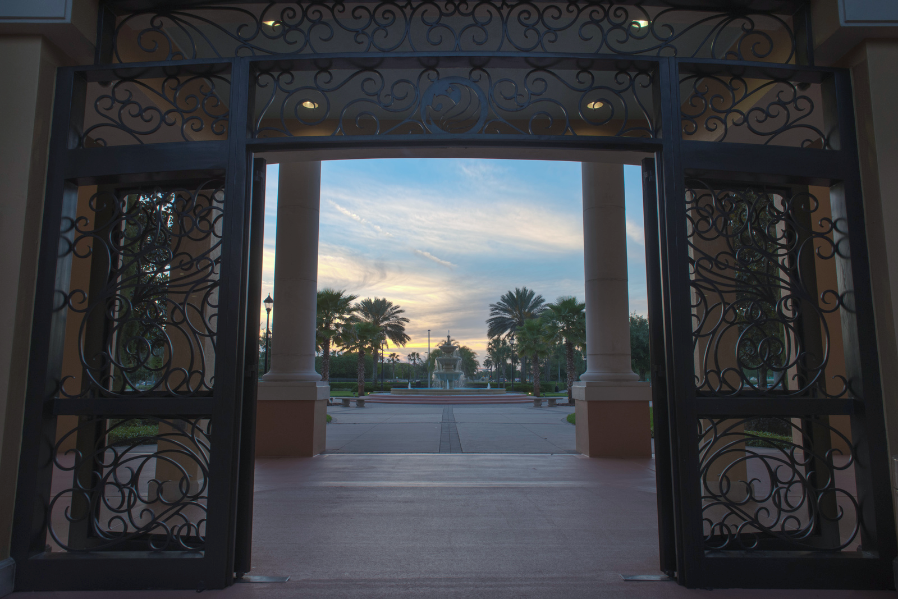


Welcome to the
Rosen College of Hospitality Management
Prostart Teacher
Training
Summer 2023!!!

Slide 2
How to Win at ProStart States!
Presented by:
Chef Arnym Solomon
Chef Jay Judy

Slide 3
About Chef Arnym Solomon CCE:
Culinary Arts/ F&B/ Educator/ Chef Instructor
Chef Solomon has Judged the ProStart National Competitions sponsored by The NRA for over 15 years, and have judged and advised competing teams on winning techniques in over 13 States.
A graduate of the Culinary Institute of America, Hyde Park New York, and member of the Board of Trustees, he also taught Culinary Arts at the CIA, and was an adjunct professor at Ecole Hotelier de Lausanne in Lausanne Switzerland, as well as Valencia College in Orlando Florida.

Slide 4
Chef Arnym Solomon continued:
Hotel Culinary and Management experience include Distinguish Alumni of The Waldorf Astoria, Sous Chef, New York City, Geneva Hilton Hotel Chef de partie, Geneva Switzerland , Garde Manger Trinidad Hilton in the Caribbean, and Executive Chef at the White Plains Hotel in White Plains New York.
Restaurants and Theme Parks experience includes TGI Friday’s, Dallas Texas, Vice President Strategic Planning Darden Restaurants Worldwide, Herman’s Restaurant development at Walt Disney World, Universal Studios and Sea World Restaurant Group and Vice President, Food & Beverage

Slide 5
About Chef Jay Judy MCTE:
Program Coordinator and Senior Instructor at the Rosen College of Hospitality Management
Chef, culinary educator, caterer, and F&B consultant with over 30 years of industry experience.
ProStart Instructor at Winter Springs High School in Seminole Country Florida for 9 years.
Florida ProStart Judge, since 2010
National ProStart Judge, 2023

Slide 6
So… What does it take to win???

Slide 7
Where to Begin?
First of all, recognize that the competition actually starts in the Fall semester, well before the first dish is actually cooked…
Let’s talk about first steps to success!

Slide 8
Setting your team up for success…
Starts with team selection!
As an instructor, team selection is everything!
Students must be willing to commit to the team and to practice, practice, practice!
Team building is huge and starts on day 1!

Slide 9
Teamwork makes the Dream work!
Team unity is just as important as their skills!
A toxic team member can torpedo a team and ruin their chances of success!
Communication must be consistent.
Trust is a must!

Slide 10
Planning the Meal
Start by asking “what is the inspiration for the dish?”
Allow students to be creative so that they can take “ownership” of the meal, but…
“Manage” their creativity!
Master fundamentals before trying experimental or modernist techniques.
Avoid doing a “twist” on a dish without understanding how the classic version should taste.

Slide 11
Guardrails in Menu Selection
Molecular Gastronomy has its place…
But should be viewed with a commonsense approach.
A question to ask is, does the technique improve the dish? Or is it a gimmick to add complexity?
For example, it is unlikely that fruit caviar would “make” or “break” a dish.
Best practices are KEY. Proper sear, proper doneness, proper temperature, proper balance, clean plate will earn more points than gimmicks.

Slide 12
A Note on Judges Preferences
The only thing in the competition that you cannot control: The judge's opinions.
Judges have personal preferences that you cannot control.
Focus on the things you can control.

Slide 13
Sanitation and Safety are HUGE
No matter how good the food looks or tastes, if it is prepared in an unsanitary manner, judges will not taste it.
Proper sanitation and safety at all times during cooking will make or break your score in competition.
Training is Key!

Slide 14
Delegation of Workload
Teams can be made up of four cooks plus a manager. The four cooks should have an even distribution of work.
Giving each student a single dish to prepare plus one student for plating and garnishing is one strategy for workload distribution, but depending on the complexity of the menu it may make more sense to divide the tasks in other ways.
Make sure the workload is manageable for each student.
Managers should be crosstrained in entire recipe collection so that they can substitute in the event of an injury.

Slide 15
Practice, Practice, Practice
Once the recipes are determined, its time to cook!
Students must commit to the practice schedule.
Within reason, practice as often as possible.
Teams should cross-train so that they understand the whole menu.
Also, remember that teambuilding includes more than just team practice.

Slide 16
Time Management
The timing of the competition should be perfected down to the minute.
As your team practices, timing should be refined, minute by minute.
You have TWO butane burners. Prime real estate that must be managed effectively.
Each team member’s time must be managed just as effectively.
Communication is KEY. Manager or timekeeper should communicate loud and clear with clear call backs from team.

Slide 17
Preparing for Travel to Competition
As the actual competition approaches you should develop a comprehensive product list that includes everything you will need. This checklist is critical. Triple check it!
Packing for travel should be given plenty of time and attention. Forgotten items can be devastating.
Pay close attention to temperature control at all times. Use ice and dry ice as needed.
Check your checklist again!

Slide 18
The Menu Packet
Make sure the packets are complete and that all elements are in correct format.
The math must be accurate! Incorrect math in food cost or pricing is a self-inflicted wound!
The food pictures do not need to be professionally photographed but they need to look good. They should match the real thing!

Slide 19
At the Competition
Keep students calm as best you can and remember that they are just kids. This event is huge for them.
Everyone is stressed out, this is perfectly normal…
Instructors need to stay calm too.

Slide 20
Those “Hidden” Points
First through third place at Nationals has been decided by less than a point.
Remember, control the things you can.
Plates should be clean and hot (or cold!)
Wipe the darn rim!
Proper technique, sear, and doneness are huge.
Make the garnish count! It should make sense too.
Portion should be appropriate.
Avoid “Deconstruction”
Avoid overly complicated presentation but make it look beautiful.
A minute late costs a point.

Slide 21


