Slide 1
Student Engagement
Chef Samantha Slechta
Chef Michael Kasper

Slide 2
Class Made Quizzes
1.Pair up students, assign a chapter/section/subject and time limit.
+Each pair writes a five/ten-question quiz about subject
+Pairs present questions to the class, and verify correct answers with explanations, definitions, and page numbers.
*The teacher takes all pertinent questions to review as possible test questions and possibly promises to use a few in the final exam or quiz.
2. Stump the class- difficulty questions/answers
+questions are scored by instructor, team with most points earn a free question on the quiz (or plus 2 points..ect…)
3. Group Presentations – 15 min to prepare, groups present in creative ways… Rap, dance, ASL incorporated, Word of the day, Vocab matching, Powerpoin, Prezzi, Fill in the blank, word scramble, crossword generator…..

Slide 3
Kahoot! https://kahoot.it/challenge/05800361?challenge-id=9705b6be-fc6a-4d08-ab15-97191dda13b5_1687310732280 Game PIN: 05800361 Sslechta
Free Basic, limit 10 players and basic features

Slide 4
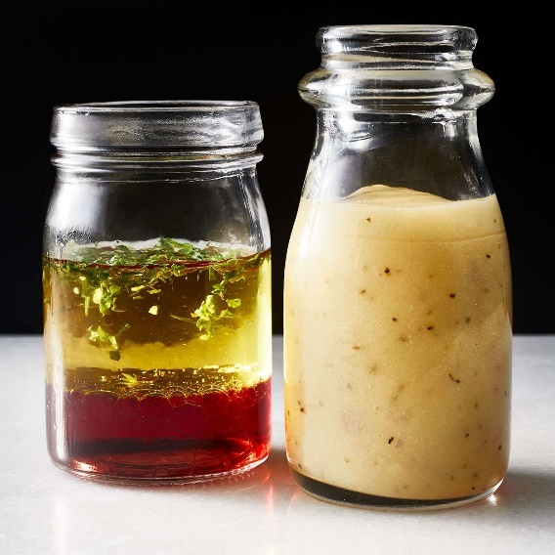
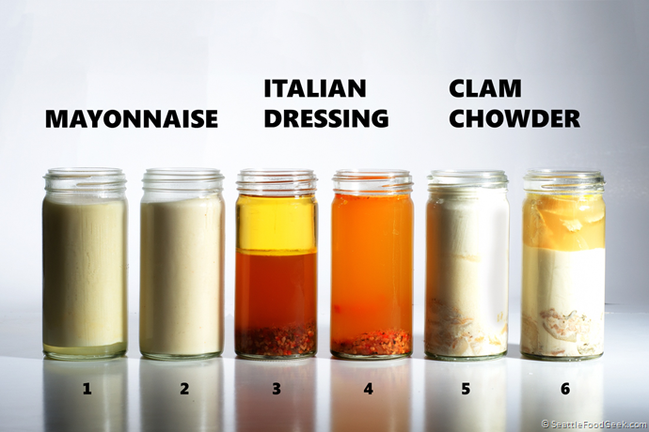
Memorization
https://youtu.be/U0er1eAm5hA
Make Acronyms
Challenge students for funny sayings, rhyms, and ways to memorize. Offer prize for best, or offer top-class bragging rights. Something will stick! If not all will stick.
….Send Sick Employees Home Now, Seriously
Competition!!!! Make it a competition.
Assign “Research project” find a youtube, picture,Gif, about Emulsification?? Share tomorrow…

Slide 5
Tips: *For faster cook times, make items smaller *Mis en Place the day before helps things go quicker *Group work with each group in charge of tasks for whole class *Multitasking/Delegating saves on time *Starting a timer and having a timescale helps to keep students on track *Making a list of goals before starting the tasks *Assigning the recipes to be rewritten as homework the night before will help with student questions, mental organization, and understanding skills expected when they arrive for class.
Each recipe will make enough to feed your group Each time you start a recipe, start the clock Each recipe should take no more than 45 minutes Keep in mind what was already prepped ahead Scones First, give time to rest/chill

Slide 6
Week Long Labs
 | Mon | Tues | Wed | Thurs
Class 1 | Discuss/Measure | Make pasta dough | Make red sauce and white sauce in teams, chill | Reheat/cook/eat/serve
Class 2
Class 3
Class 4

Slide 7
Butterscotch Pudding
Molasses Cookie
Molasses Cookie
Subtitle
Ingredients
1 Cup AP Flour
½ tsp. BS
½ tsp. ground cinnamon
¼ tsp. ground ginger
¼ tsp White Pepper
¼ tsp. Salt
6 TBS Butter - Softened
½ cup Sugar
1 Egg
2 TBS Molasses
Procedure
Cream butter and sugar with a paddle attachment, on medium, until light and fluffy, about 3 minutes. Scrape down sides, beat in egg, scrape down sides, add molasses, scrape down sides.
Sift all remaining dry ingredients.
Add in dry ingredients until just combined. Just 30 seconds! Do not Over Mix!
Wrap in plastic and chill for 2 hours minimum.
Preheat oven to 350
Let the dough warm up on table, pull off 1-inch pieces and roll into balls. Space well on parchment lined sheet tray. Bake for 10-12 minutes.
Ingredients
1 Cup plus 2 TBS Whole Milk
1 Cup Heavy Cream
3 TBS Butter
½ Cup plus 2 TBS Brown Sugar
2 Egg Yolks
1 ½ TBS Cornstarch
¼ tsp. Salt
1 ½ tsp. Vanilla extract
1 TBS Confectioners Sugar
¼ tsp. Fresh ground black pepper

Slide 8
Butterscotch Pudding
For the Pudding
Before you start
Procedure
Combine milk and .5 cups of the cream in a saucepan and bring to a simmer over medium heat. Immediately remove from heat.
In an 8-inch sauté pan, melt butter and add brown sugar. Cook 5-6 minutes stirring consistently, to caramelize the mixture. When the butter starts to brown and a nutty aroma is noticed take off of the heat.
Add the brown sugar mixture gradually to the hot cream. Whisking constantly.
Whisk egg yolk, cornstarch, and salt in a bowl.
Temper cream and Egg mixtures.
Whisk consistently over medium heat until reaches a boil. About 3 minutes. The pudding will become thick.
Pour into 4 oz ramekins, chill.
Whip ½ cup heavy cream until soft peaks. Stir in pepper and confectioners sugar.
Serve with cookie and whipped cream.
Tempering:_________________________________________________________________________________________________________________________________________________________________________________________________________________________________
Discuss with class and leave blanks in recipes for students to write in for verification they understand.

Slide 9
Thank you
Samantha Slechta
sslechta@keiseruniversity.edu
9-41-893-8360

Slide 10
keiserchefssrq
WiFiStuKU

