Slide 1
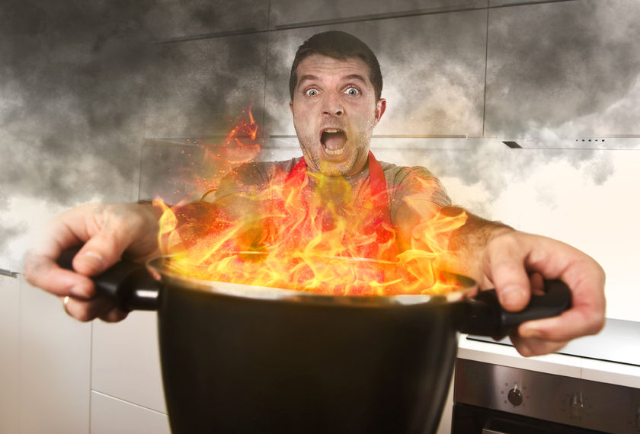
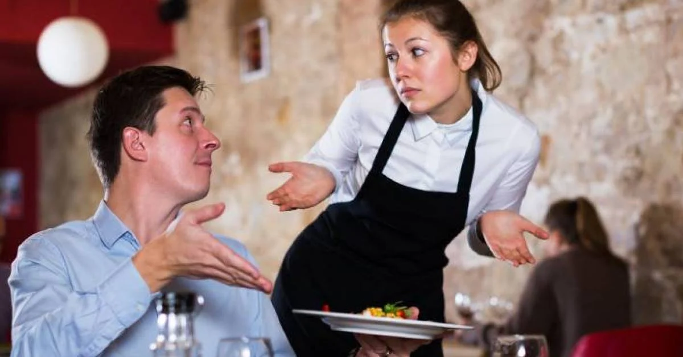

Restaurant Management Madness!!!
with
Chef Jay Judy

Slide 2
You are the manager!!!
How would you handle the following scenarios?

Slide 3

Scenario 1
Front of House:
A server drops a large tray of glassware on the floor in the middle of the dining room during the dinner rush…
…and there is broken glass and liquid everywhere!

Slide 4
Scenario 2
Front of House:
A guest at the restaurant has fainted during their meal and is unconscious…
…What should you do first, and then afterwards to address the situation?

Slide 5
Scenario 3
Back of House:
A guest has sent back a steak for being undercooked. You re-fire the steak and re-plate it before sending it out…
…and now the customer says that it is overcooked. What do you do?

Slide 6
Scenario 4
Back of House:
You observe a new cook consistently walking behind the hot line during service without alerting the other cooks…
…How would you handle the situation?

Slide 7
Scenario 5
Back of House:
You are training one of your cooks to properly put store raw proteins upon delivery from the supplier…
…What are the steps necessary for safe handling practices where ?

Slide 8
Scenario 6
Back of House:
You are closed for the day due to a holiday, and when you return the walk temperature is 75 degrees. The food seems cool, so you are considering using it…

Slide 9
Now it’s your Turn!
Work with your group to develop your own case study and solution
You have 5 minutes!

Slide 10
Competition Q&A

Slide 11
Table 1

Slide 12
Table 2

Slide 13
Table 3

Slide 14
Table 4

Slide 15
Table 6

