Slide 1


Welcome to Rosen College
Florida Prostart Teacher Training

Slide 2
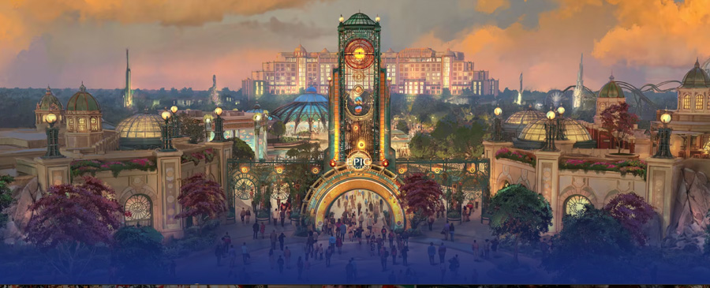
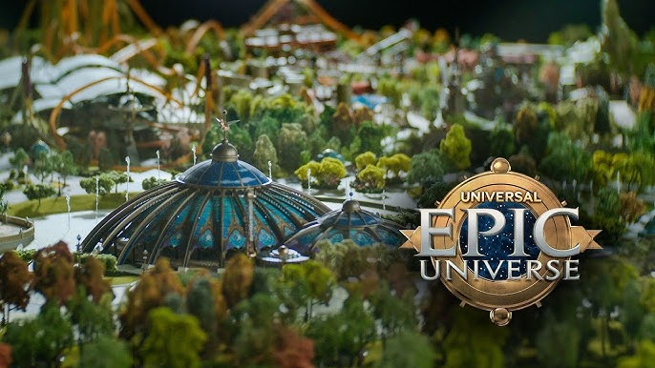
“Epic” Theme Park Menu Battle
UCF Rosen College of Hospitality Management / Florida Prostart

Slide 3
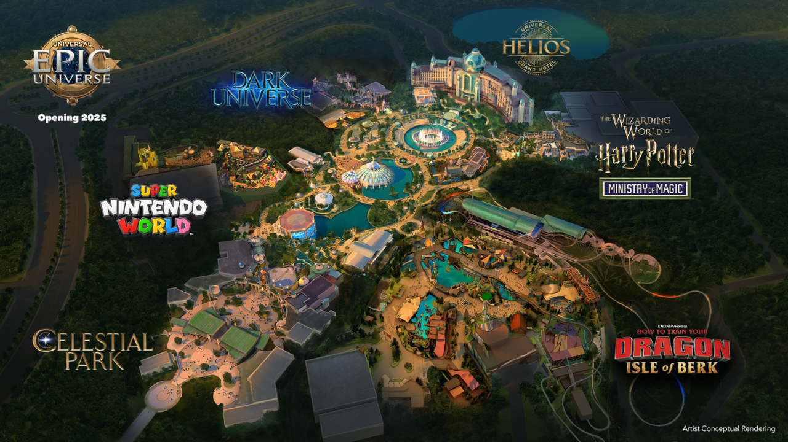

C
Rosen College of Hospitality Management

Slide 4
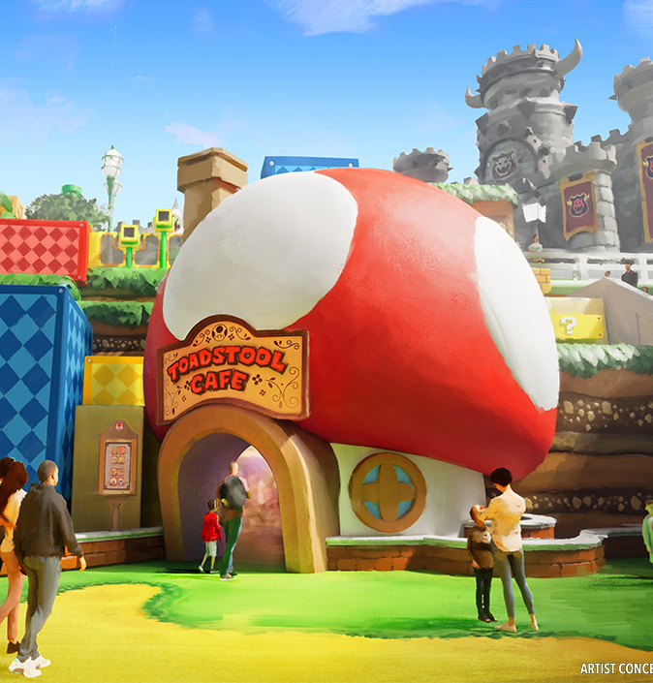
PROSTART MENU BATTLE
A Teams select a world within Epic Universe
B Build a themed menu
C Menu will have 3 creative dishes
D Groups will present menus
E Reflection

Slide 5
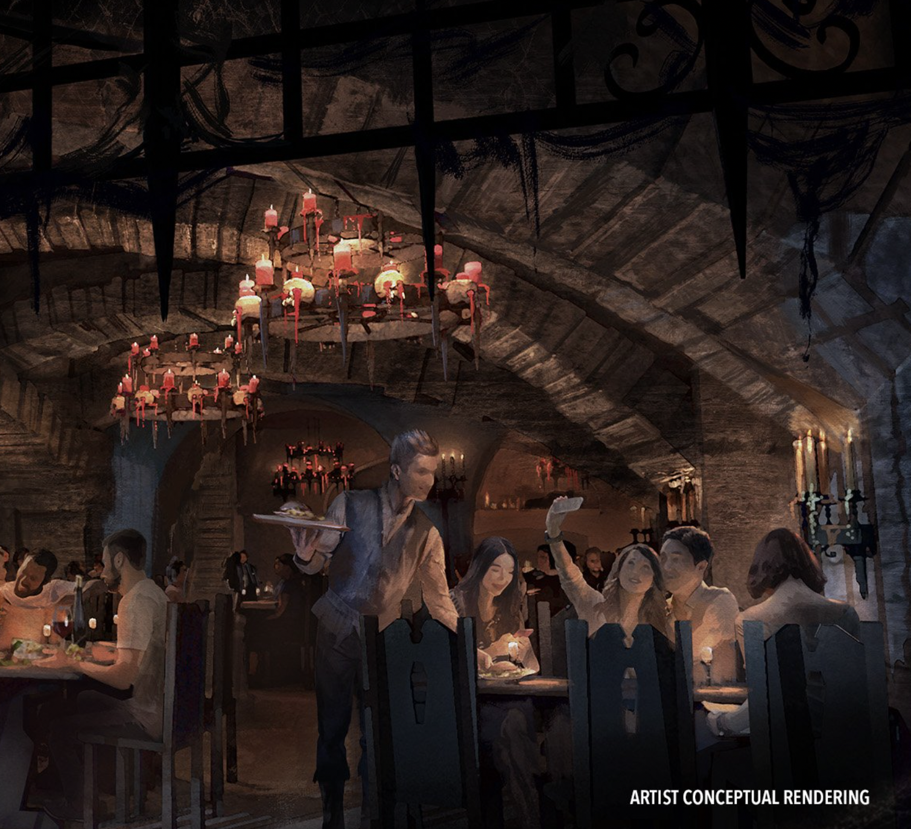
WORLDS of EPIC UNIVERSE
1 Celestial Park
2 Super Nintendo World
3 Dark Universe
4 The Wizarding World of Harry Potter
5 How to Tame your Dragon – Isle of Berk

Slide 6
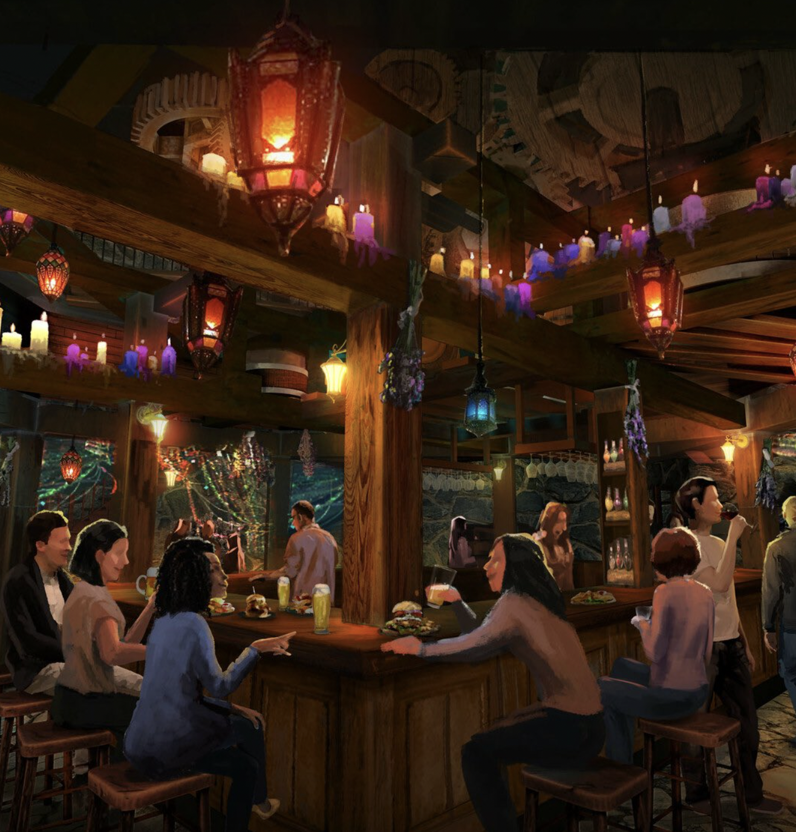
INTRODUCTION TO MENU BATTLE
MENUS SHOULD BE:
  UNIQUE
  FUN
  PORTABLE
  VISUALLY APPEALING
  DRAW GUESTS TO PARK
  FIT WELL WITH THEME + TARGET AUDIENCE

Slide 7
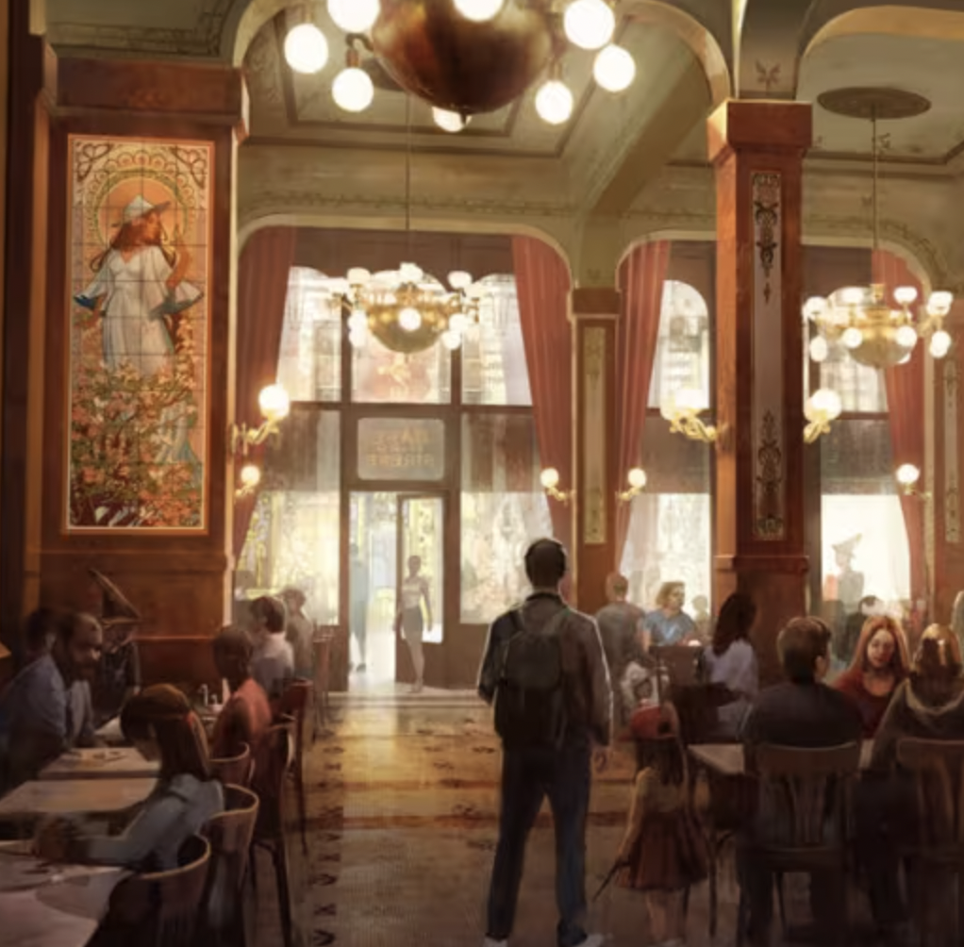
BRAINSTORMING & PLANNING
45 minutes
CONSIDER THE FOLLOWING:
THEME & CONCEPT: HOW DOES THIS MENU FIT HERE? WHY EPIC UNIVERSE + IN THIS SPECIFIC WORLD
TARGET AUDIENCE: WHO IS THIS MENU FOR? KIDS, FAMILIES, ADULTS?
CREATIVITY & PRESENTATION: HOW DOES IT STAND OUT? DESCRIBE THE DISH
NAME & STORY: CREATE A BACKSTORY FOR EACH DISH

Slide 8
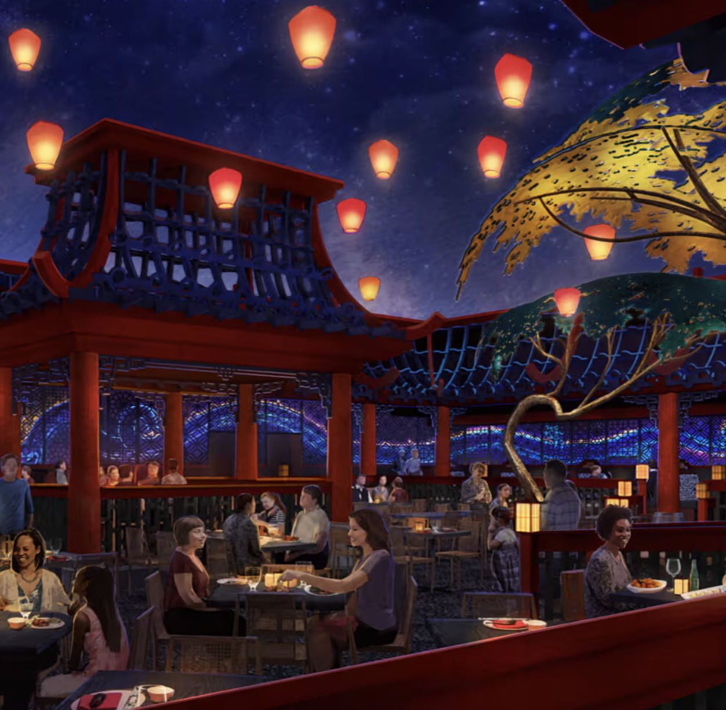
PRESENTATION TIME!
MENUS ARE PRESENTED TO CLASS
GROUPS WILL EXPLAIN CONCEPT + THEME
PRESENT THE STORY BEHIND EACH DISH
IDENTIFY THE TARGET AUDIENCE

