Slide 1
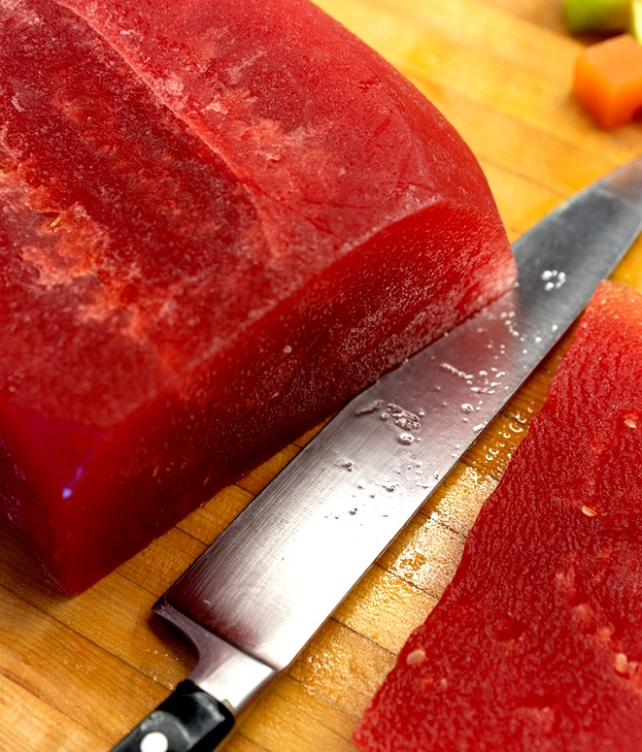
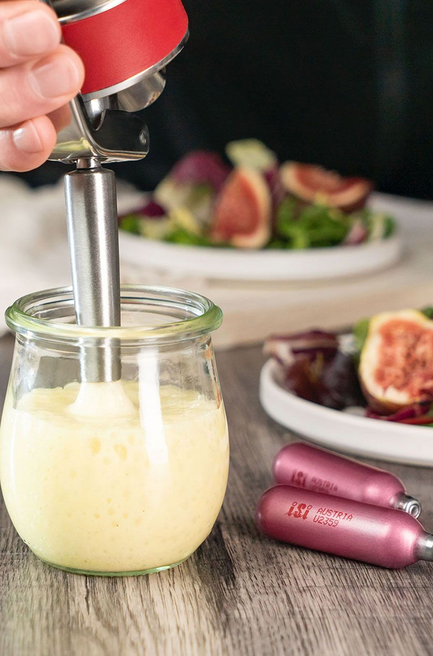
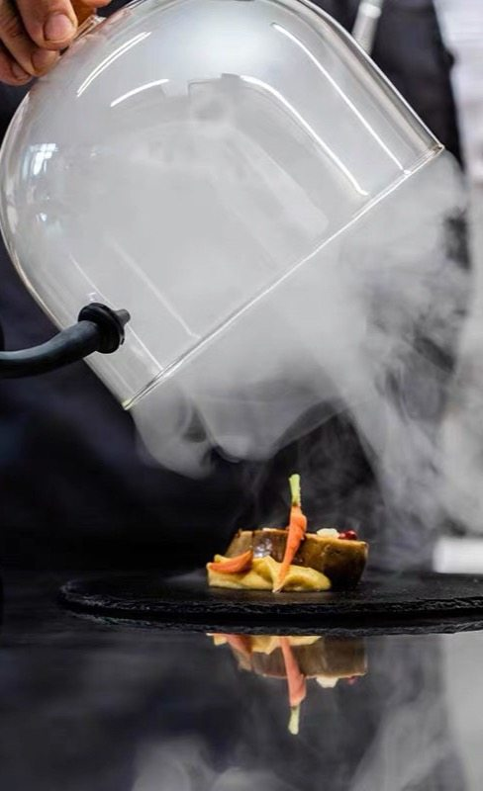

Modernist Techniques
UCF Rosen College
Cesar Rivera-Cruzado M.Ed.

Slide 2
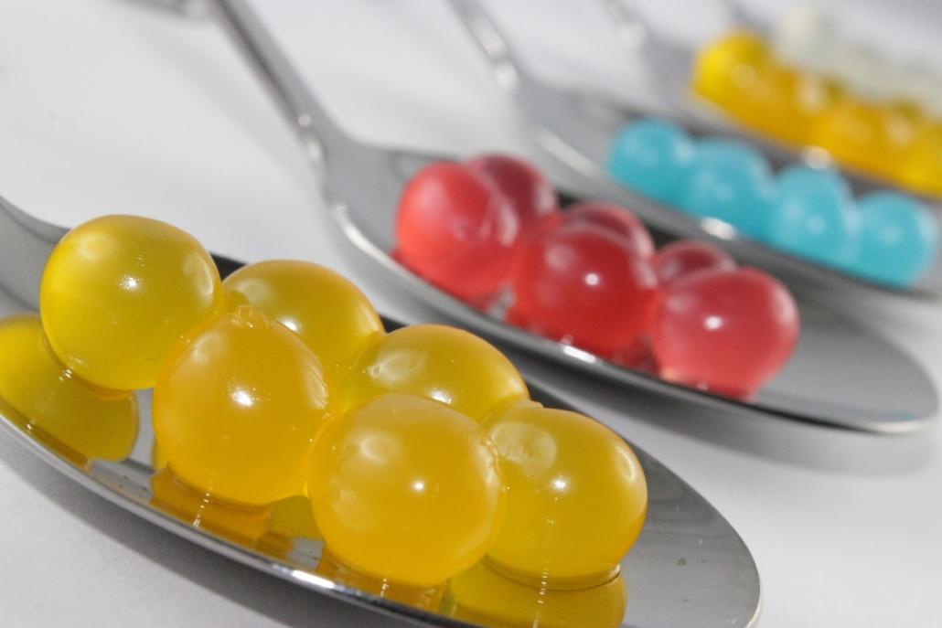

AGENDA
Introduction
Vacuum Techniques
Sous-Vide Techniques
Siphon Techniques
Cold Smoking (The Smoking Gun)
Hand-on Experimentation
Presentation & Reflection

Slide 3
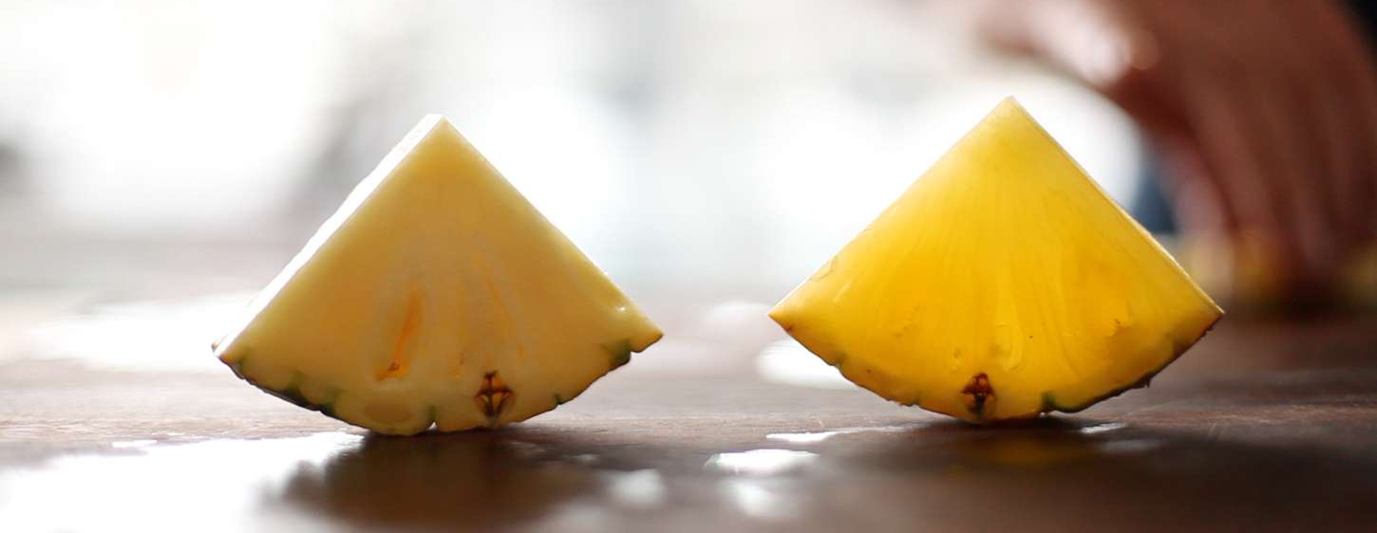
Vacuum Techniques

Slide 4
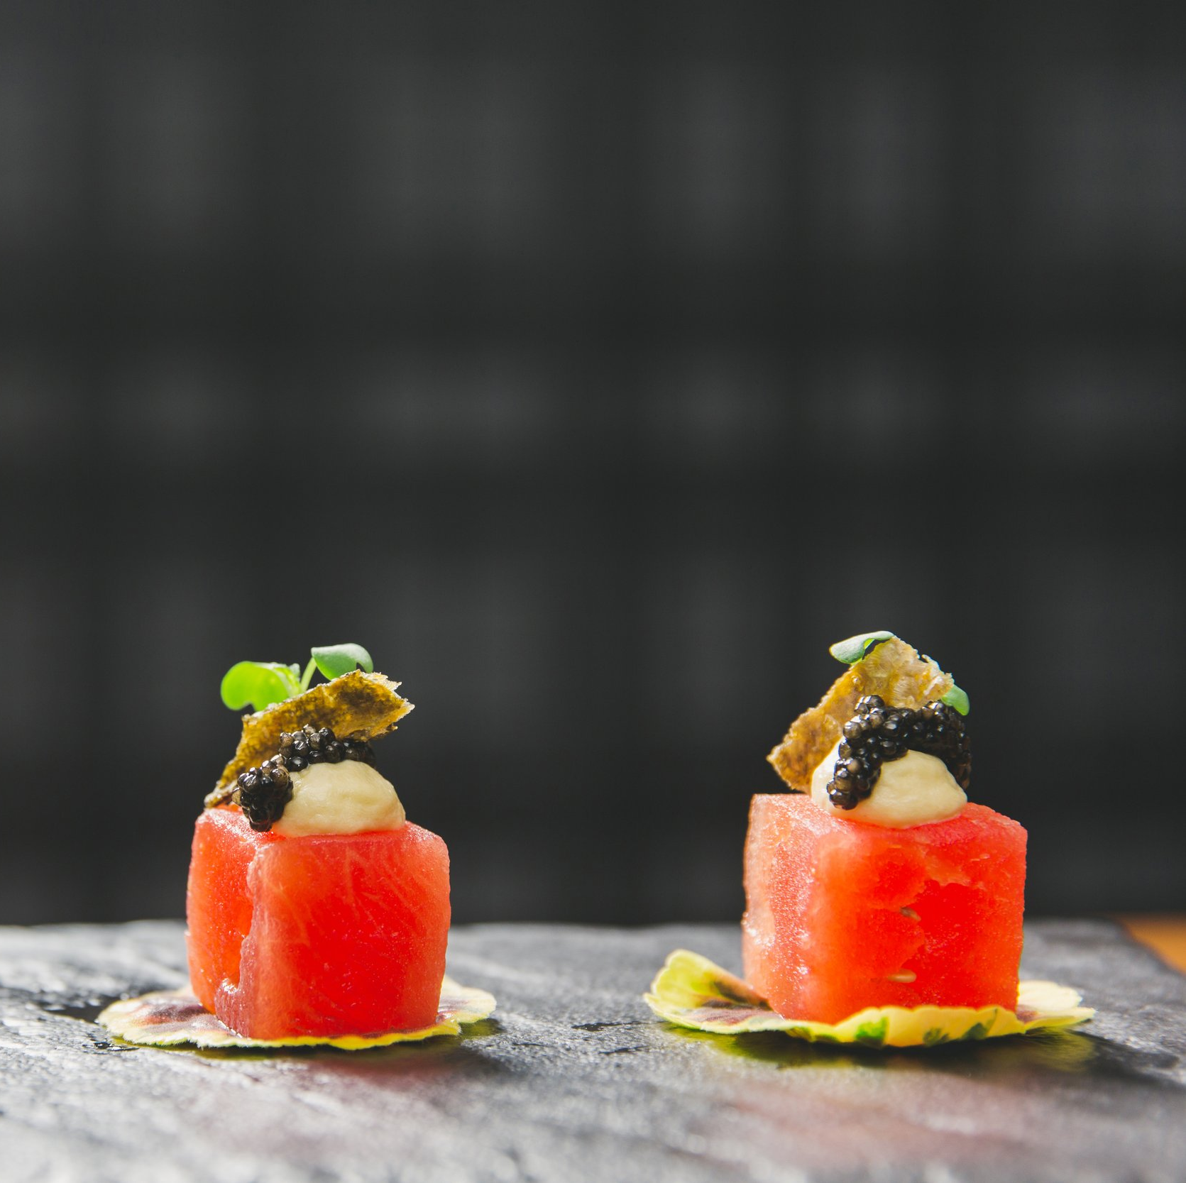
How a Vacuum Works
This technique exploits the ability of a vacuum chamber to reduce surrounding pressure, which causes air and moisture within the plant tissue to rapidly expand and rupture structures within the food.
When surrounding pressure is restored to a normal level, the labyrinth of air-filled spaces collapse. As a result, light tends to pass through the food rather than being scattered and diffused, which is why vacuum-compressed plant foods appear translucent.

Slide 5
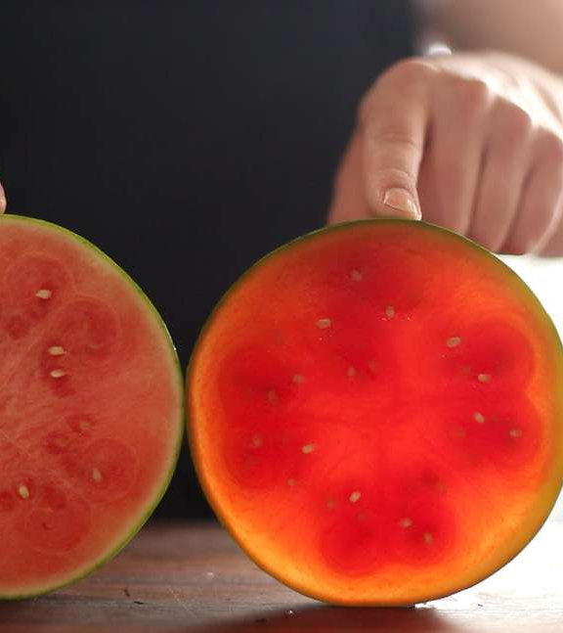
Instant results
Compression occurs as quickly as air rushes back into the chamber sealer. If you watch closely, you can watch a compressed fruit or vegetable turn translucent. Here, you can see the difference between uncompressed (left) and compressed (right) slices of watermelon.

Slide 6
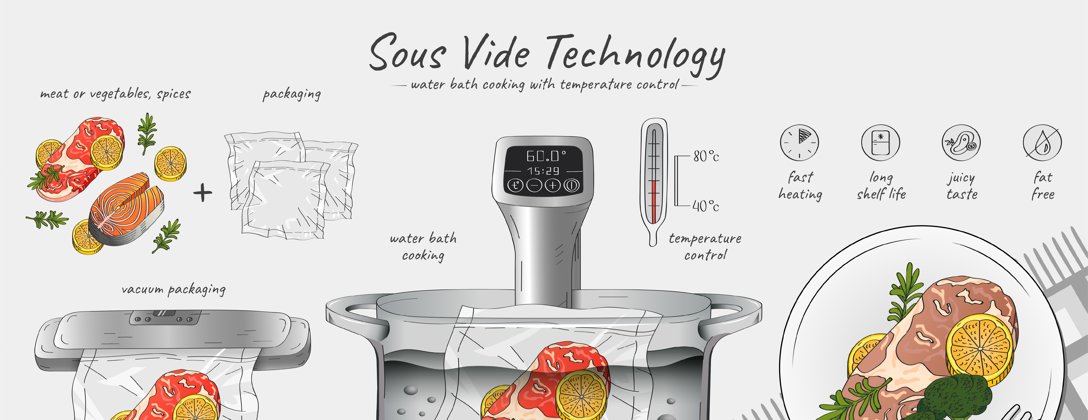
Sous-vide techniques

Slide 7
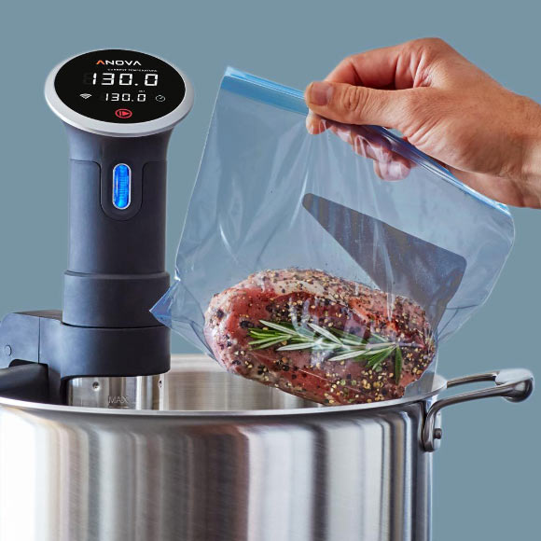
How Sous-Vide Works
What Is Sous Vide?
Sous vide is a cooking method in which food is vacuum-sealed in a bag and gently cooked in a precisely controlled water bath at a low temperature. The term "sous vide" means "under vacuum" in French. This technique ensures even cooking, improved moisture retention, and enhanced flavor and texture.
Key Feature: Precision Temperature Control
Unlike traditional high-heat methods, sous vide relies on exact temperature control to achieve consistent results. Food is slowly brought to the target temperature and held there, eliminating the risk of overcooking. For instance, a steak cooked at 130°F (54°C) will be evenly medium-rare from edge to center.

Slide 8
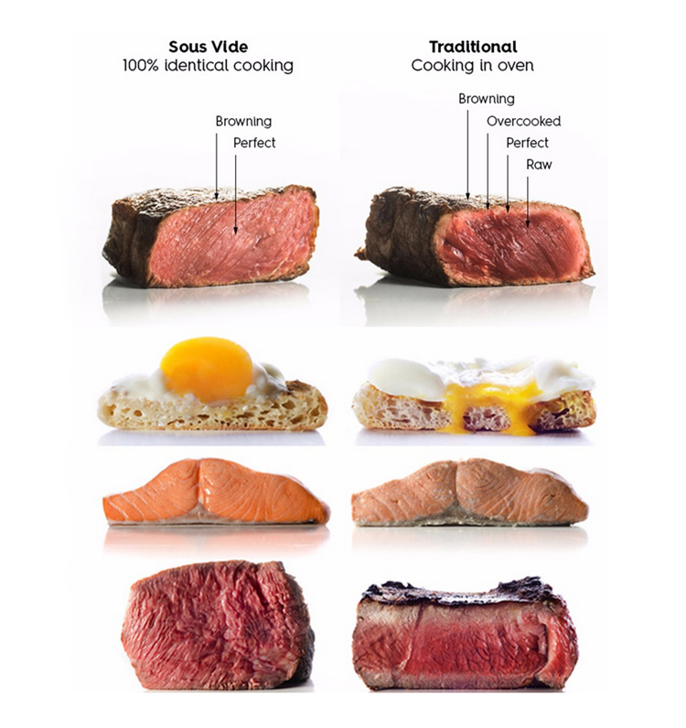
Advantages
1. Precision Cooking
Maintains exact temperature for perfect doneness
Eliminates risk of overcooking
2. Enhanced Flavor & Texture
Vacuum sealing locks in juices and aromas
Results in tender, evenly cooked food
3. Convenience & Consistency
Set it and forget it — minimal supervision needed
Reproducible results every time
4. Nutrient Retention
Gentle cooking preserves vitamins and minerals
Less nutrient loss compared to high-heat methods
5. Versatility
Ideal for meats, fish, vegetables, eggs, and desserts

Slide 9
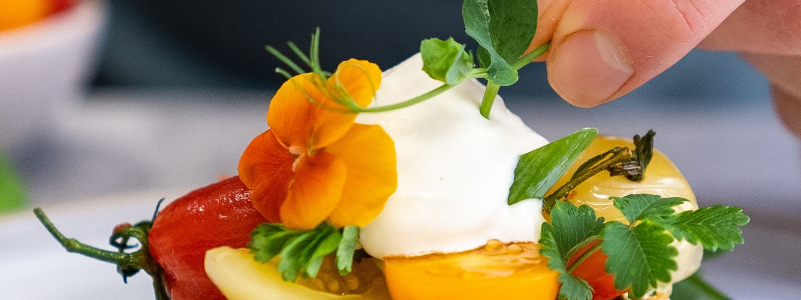
Siphon Techniques

Slide 10
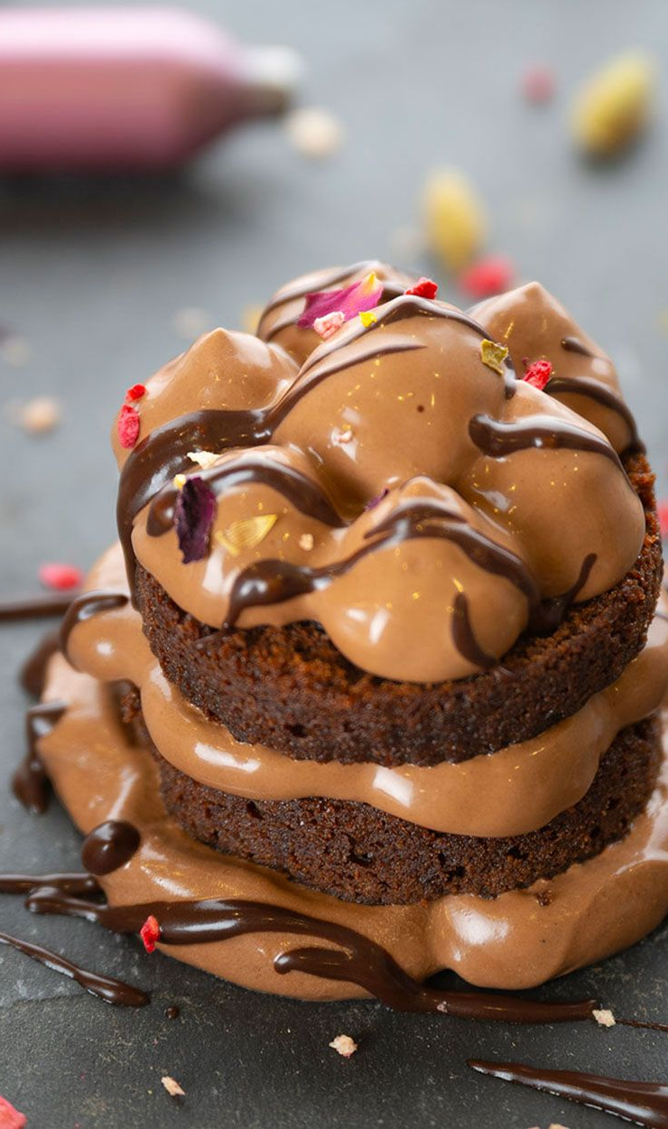
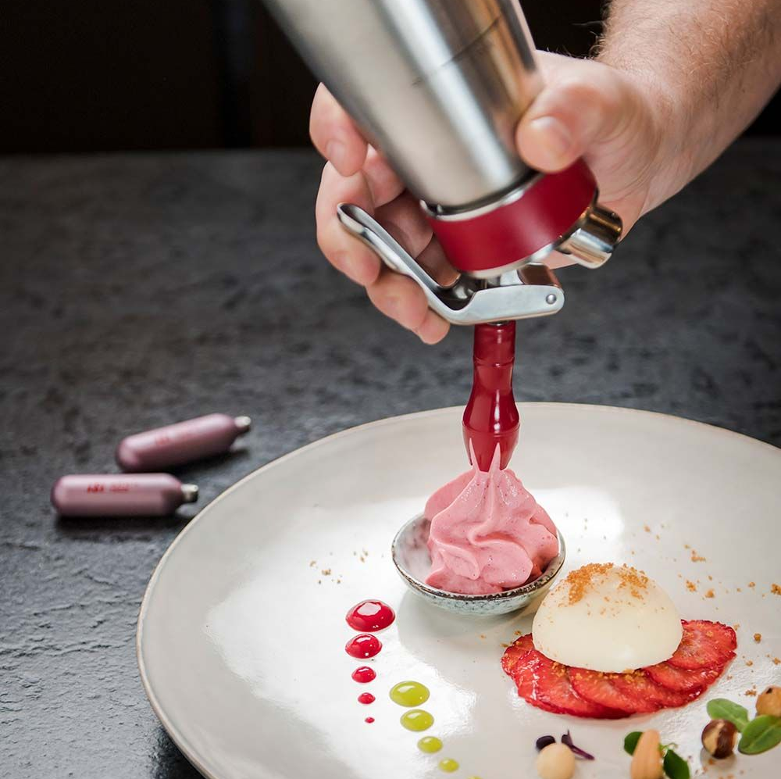
Whipping Siphons: A Brief Introduction
A whipping siphon also known as a cream whipper, is a kitchen tool used to create foams, whipped cream, and other aerated foods by using pressurized gas.
By introducing gas into liquids or mixtures, they create a pressurized environment that unlocks a multitude of creative possibilities.

Slide 11
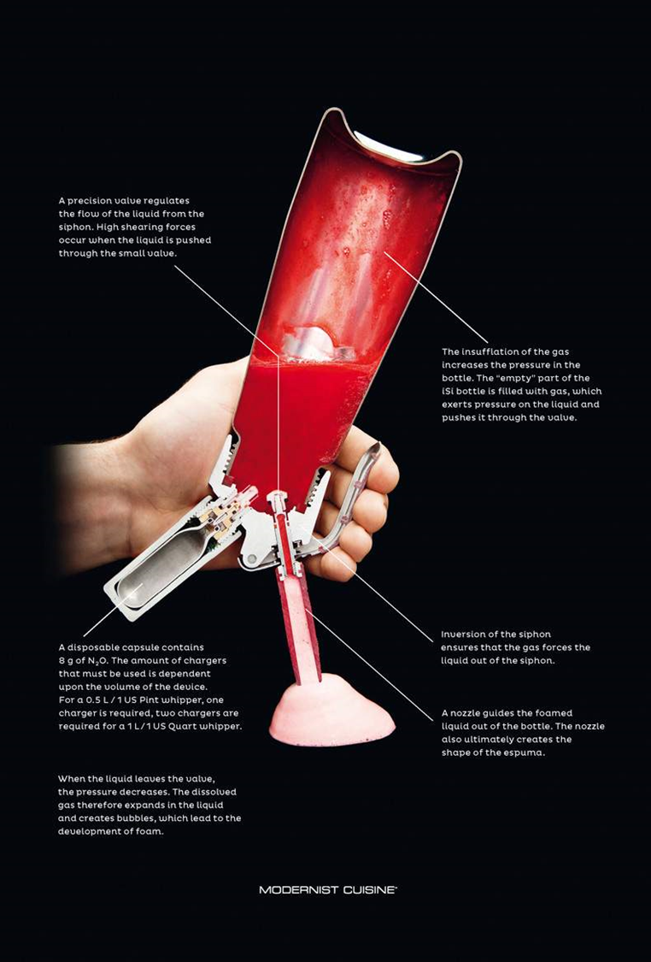
How a Whipping Siphon Works
What' s Inside?
A whipping siphon consists of a canister with a lid, a gasket, and a lever. You fill the canister with liquid or even solid food (for infusions), then screw on the lid.
Pressurization
Next, you charge the siphon by inserting a gas cartridge (either nitrous oxide or carbon dioxide) and tightening it. The gas inflates inside the canister, binding with the cream or other ingredients.
Texture Magic
When you press the lever, the pressurized gas escapes, creating a fluffy, whipped texture. Traditionally, it’s used for whipped cream, but there’s so much more you can do!

Slide 12
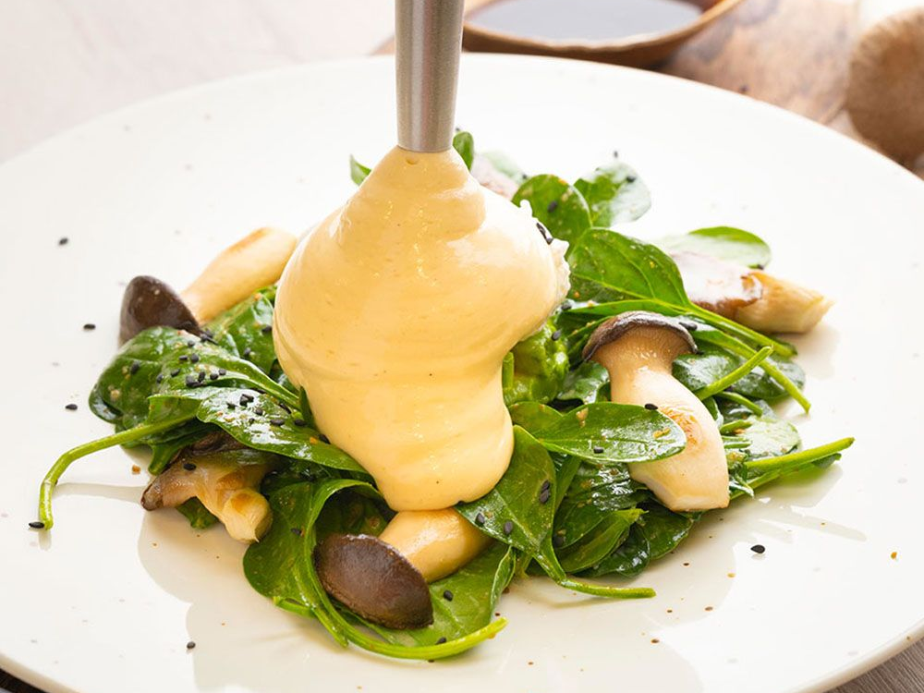
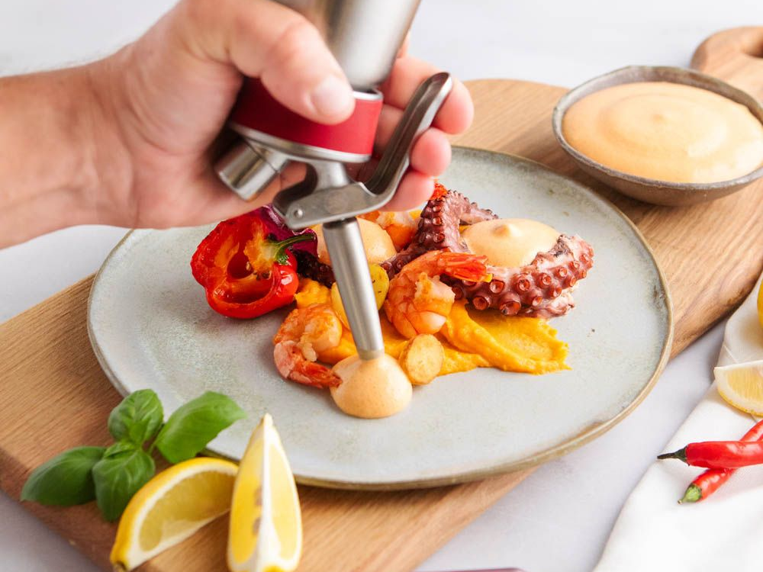
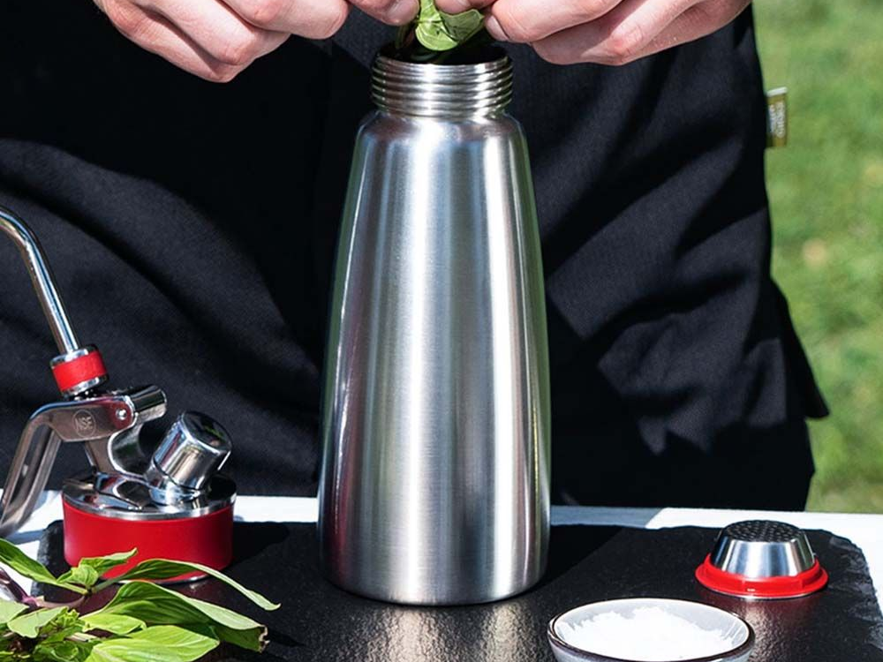
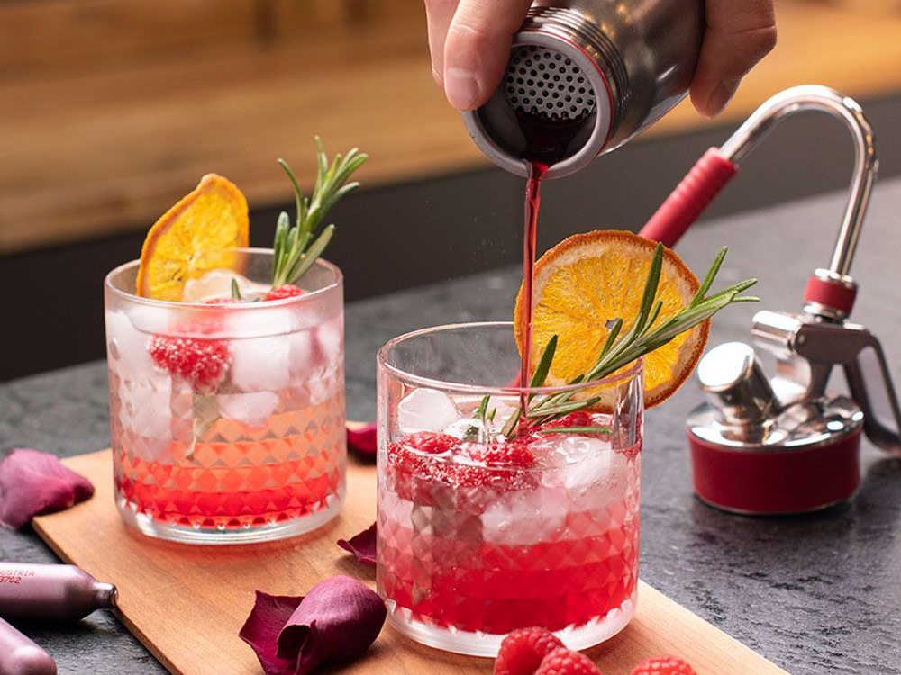
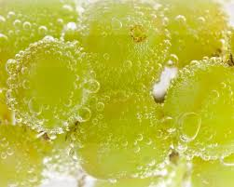
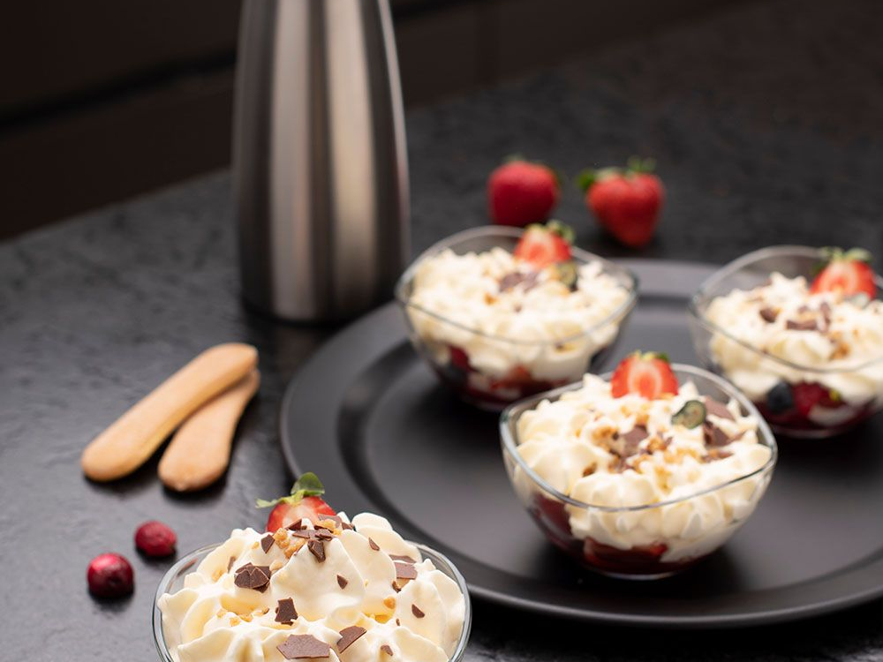
Creative Uses for Whipping Siphons
Foams
Gels
Quick Pickling
Create light and airy foams from flavored liquids like fruit juices, coffee, or herb-infused broths.
Turn liquids into gel-like textures for unique plating and flavor experiences.
Infuse pickling liquids with flavors rapidly—think kimchi or other pickled veggies.
Infusions
Carbonation
Long-Lasting Whipped Cream
Flavor oils, spirits, or vinegars by infusing them with herbs, spices, or fruits.
Use carbon dioxide cartridges to carbonate beverages or even fruits.
Homemade whipped cream stays fresh and fluffy for up to 10 days in a siphon.

Slide 13
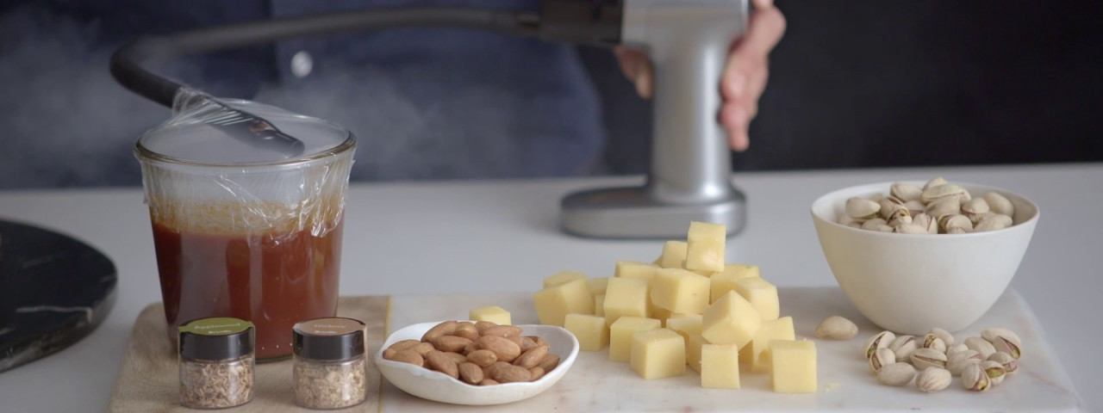
Cold Smoking (The Smoking Gun)

Slide 14
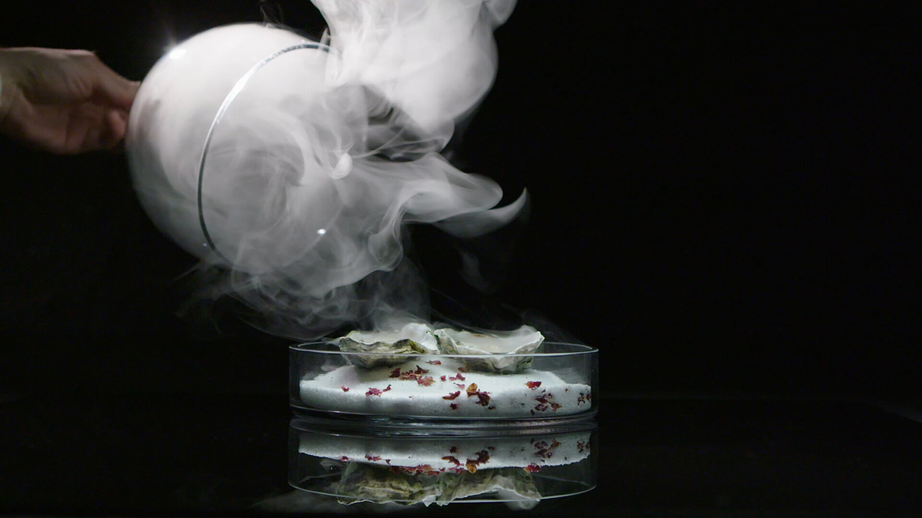
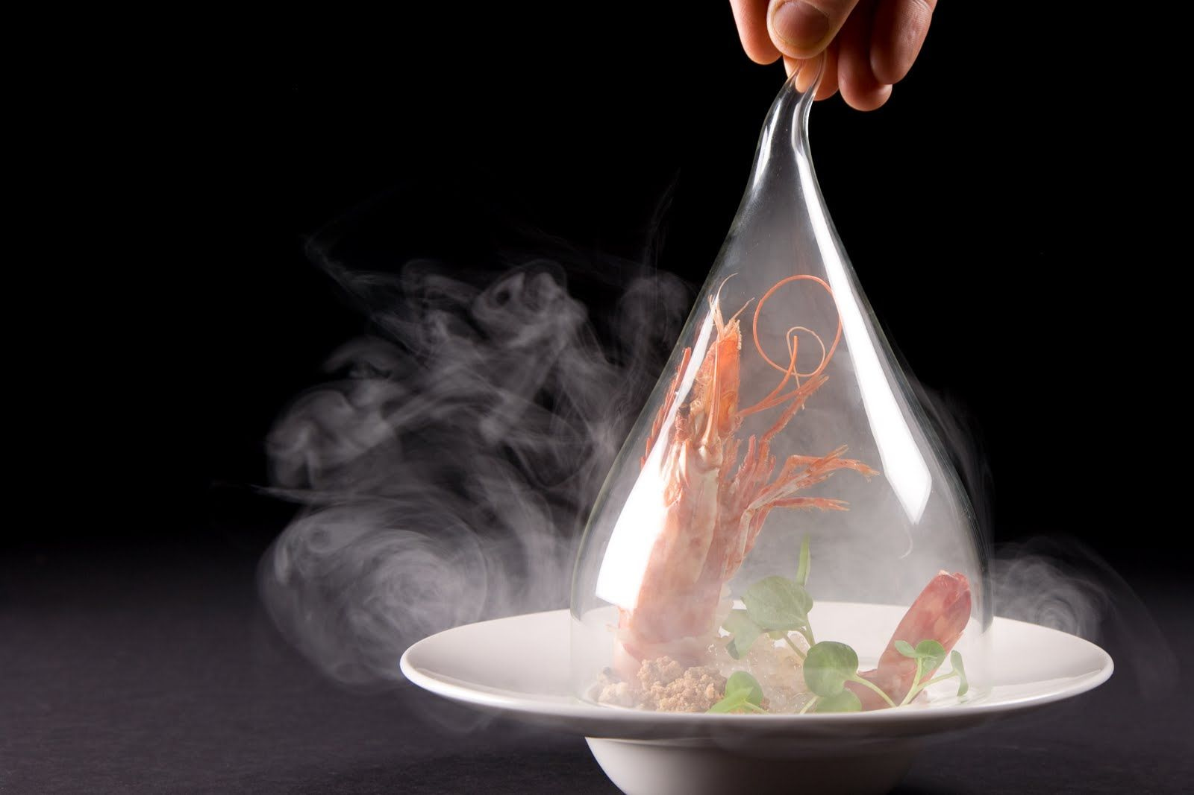
Cold Smoking: A Brief Introduction
Cold smoking is a method of infusing food with smoke flavor without applying significant heat, typically keeping the temperature below 90°F (32°C). This is distinct from hot smoking, which both cooks and smokes the food at higher temperatures.
A "Smoking Gun," such as the Breville or PolyScience models, is a handheld device specifically designed for cold smoking.

Slide 15
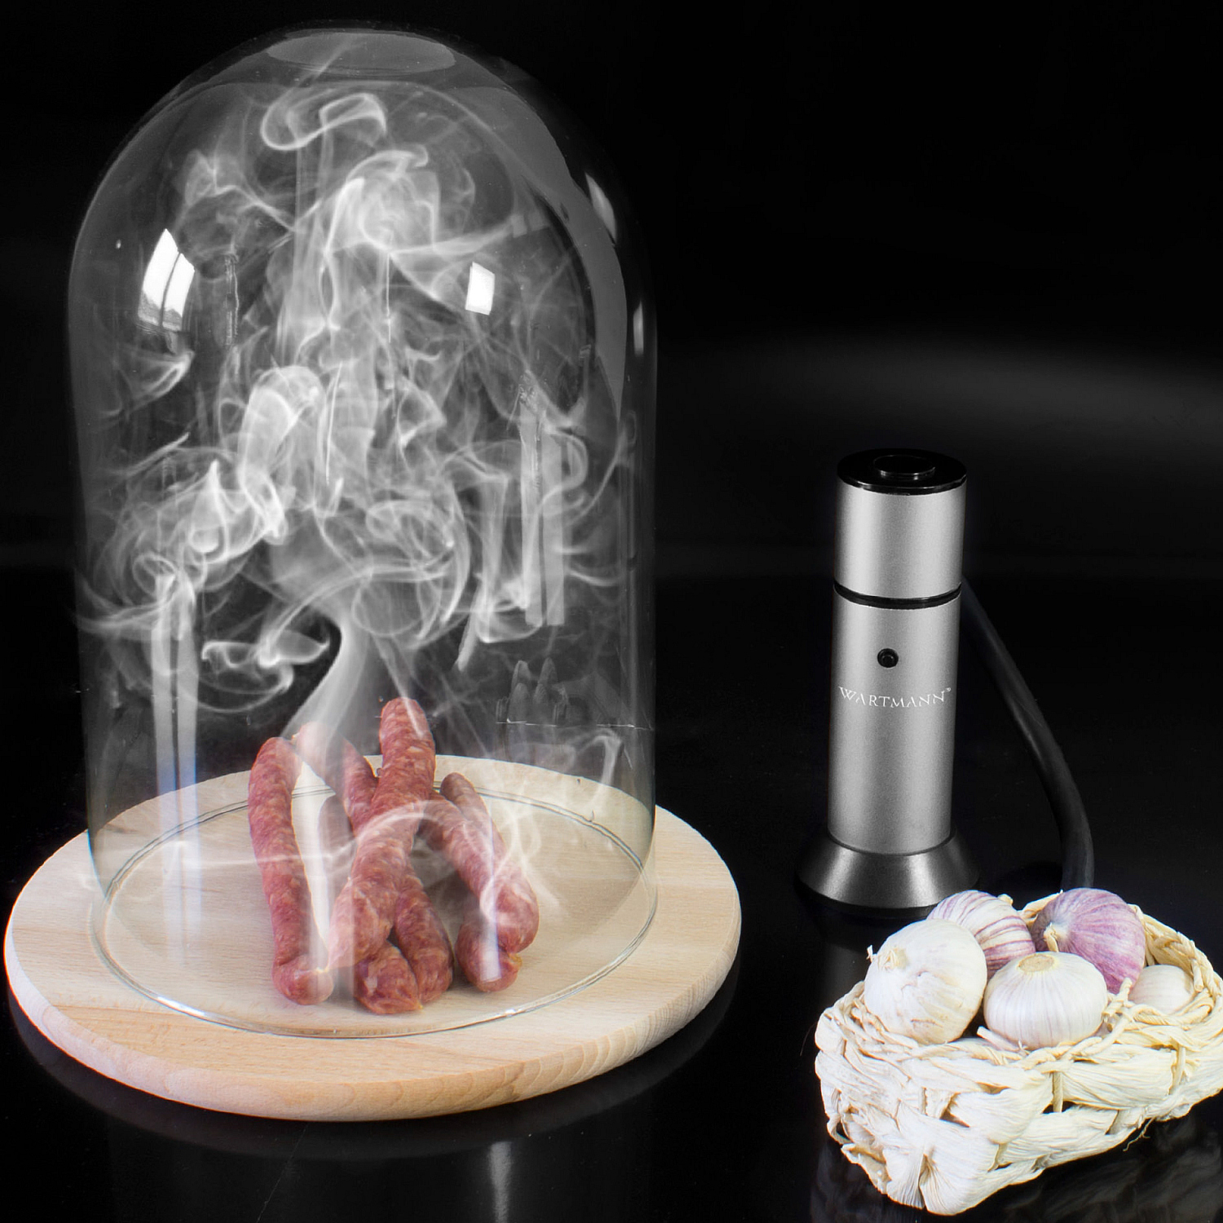
How Cold Smoking Works
How it Works:
Combustibles: The smoking gun burns small amounts of materials like wood chips, herbs, spices, or even dried flowers.
Cold Smoke Generation: The device produces cool, filtered smoke, which is then directed into a container or directly onto the food.
Infusion: The food absorbs the smoky flavors without being cooked.

Slide 16
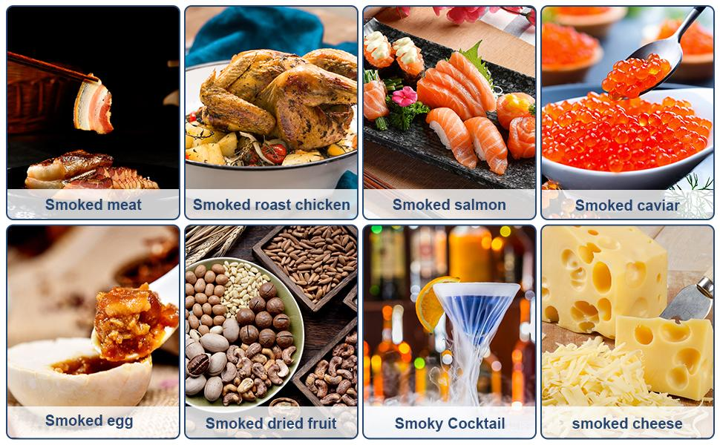
Benefits of Cold smoking:
Flavor Enhancement: Adds a unique smoky flavor to various foods and drinks without altering their texture or temperature.
Versatility: Can be used on delicate foods like ice cream, butter, cocktails, or meats and cheeses.
Convenience: Offers a quick and easy way to add smoke flavor compared to traditional smoking methods.
Portable: Handheld and often battery-operated, making it easy to use indoors or outdoors.

Slide 17
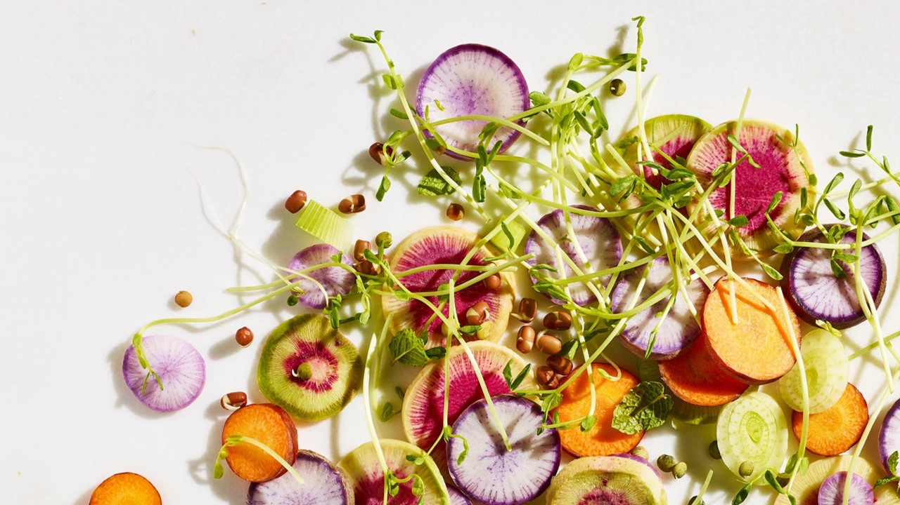
Recipes

Slide 18
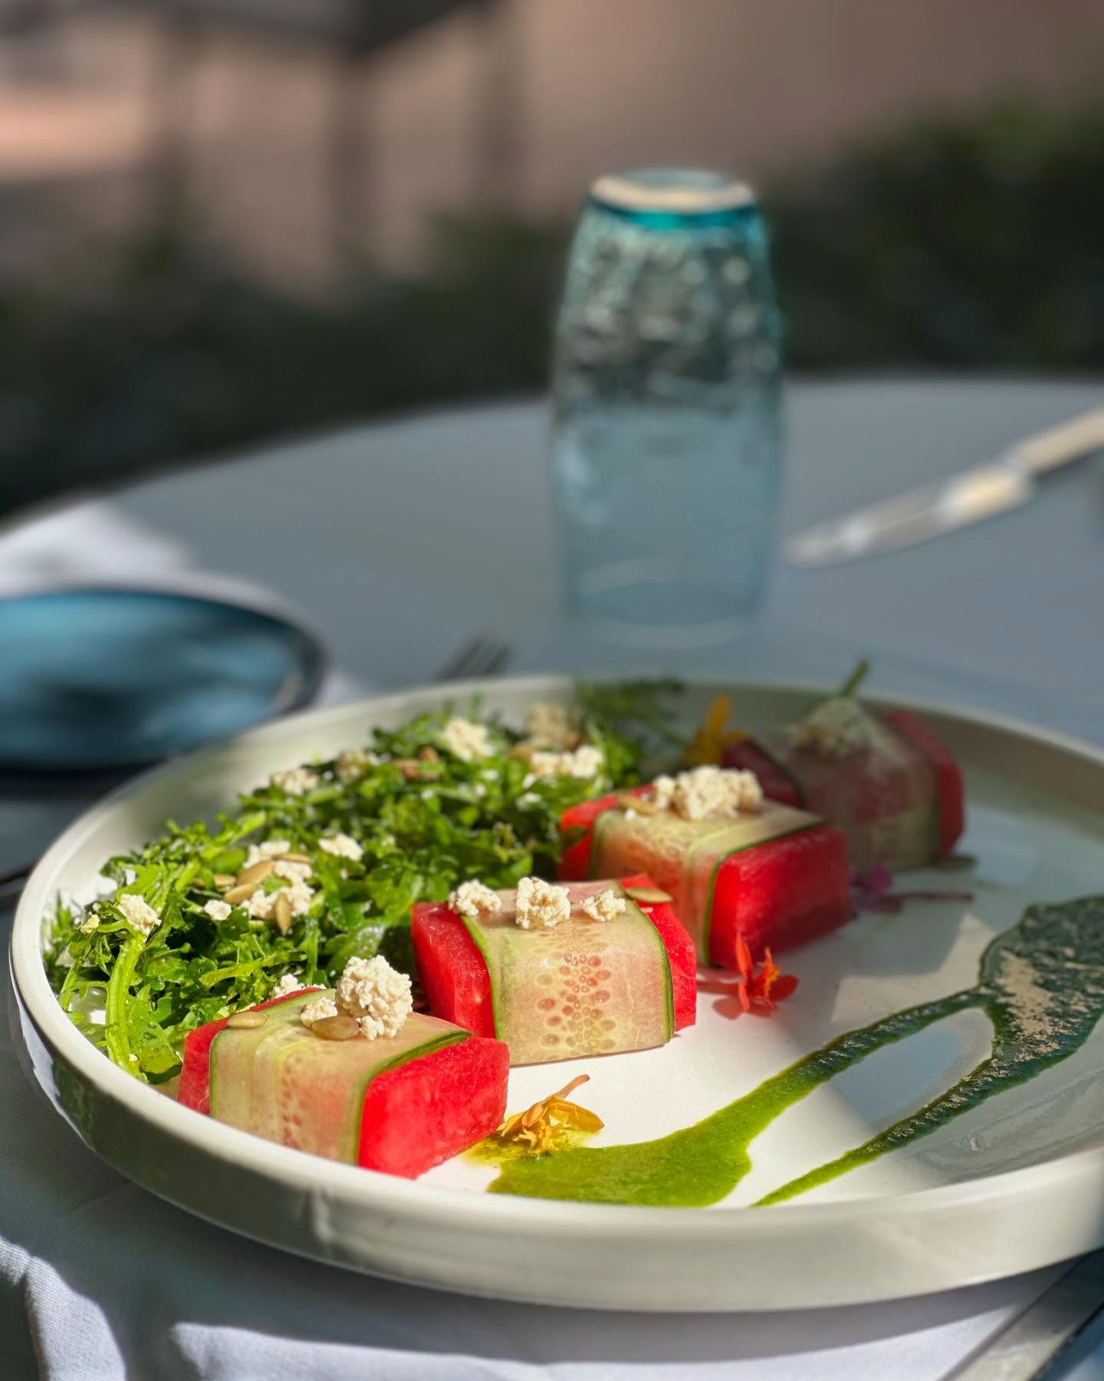
Compressed Watermelon & Cucumber Salad
ingredients
preparation
8oz Watermelon, sliced 1”
1ea English cucumber, sliced
Salt to taste
1 tsp. Lemon zest
2 tbsp Lemon juice, fresh
2 tbsp Mint, fresh, chopped
2 oz Fetta cheese, crumble
Tajin to taste
Extra virgin oil
Place the sliced and seeded watermelon into a vacuum bag.
Using a chamber vacuum sealer, seal the bag at 100% vacuum to compress the fruit.
Repeat the same process with the sliced cucumbers.
Just before serving, combine the compressed watermelon, cucumbers, and all remaining ingredients in a large bowl. Toss gently to mix.
tip
Toasted nuts (like pistachios or almonds), pickled onions, or microgreens can add crunch and complexity.

Slide 19
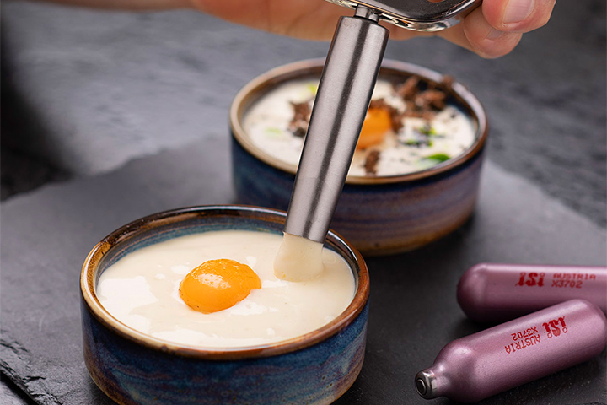
Warm Potato Espuma
ingredients
preparation
1 pinch of Salt
10 oz Milk
4 oz Potato water
6 oz Butter
1 pinch of Nutmeg
14 oz Potato
1. Cook the Potatoes: Peel the potatoes and boil them in salted water until fully cooked. Strain well. Important: Do not mash the potatoes.
2. Prepare the Mixture: While the potatoes are still hot, mix them with hot milk, some of the reserved potato cooking water, and butter until smooth and well combined.
3. Season and Fill the iSi Unit: Season the mixture with salt and nutmeg. Pour it into a hot 0.5 L iSi Whip.
4. Charge and Shake: Screw on 1 iSi Cream Charger, then shake the bottle vigorously. Serve immediately or keep the iSi unit warm in a bain-marie (hot water bath) at a maximum of 75 °C (167 °F).
tip
For a gourmet twist, add a few drops of truffle oil to the mixture before charging.

Slide 20
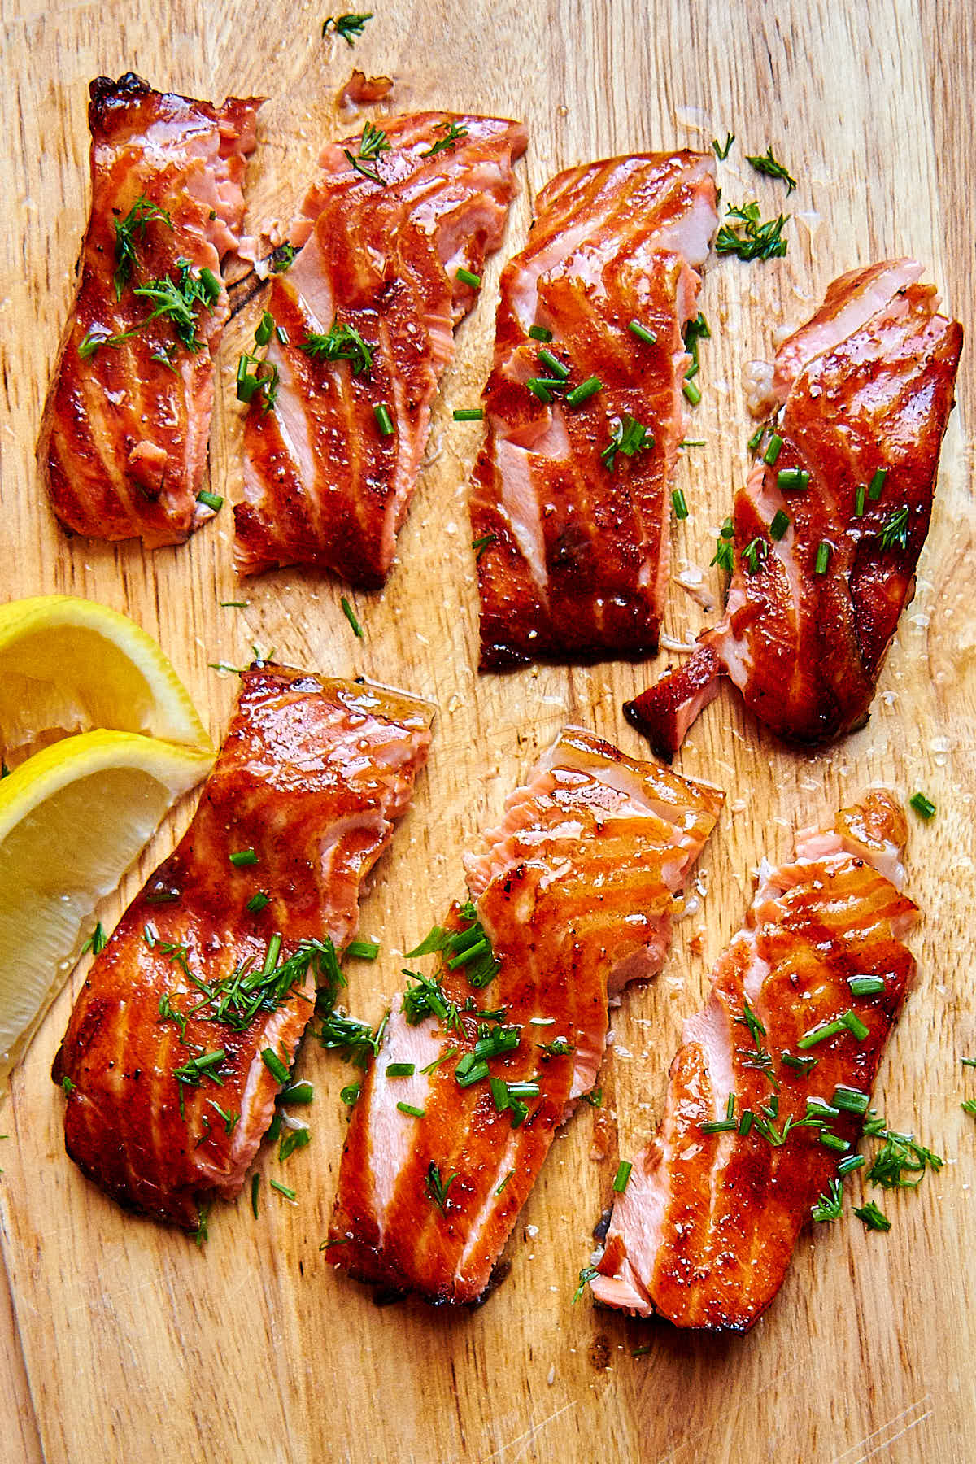
Sous Vide Smoke Salmon
preparation
ingredients
4 cups Water
1/4 cup Kosher salt
5 Salmon fillet (5oz)
2 oz Olive oil
1. Prepare a wet brine & Submerge the fish in the brine for 10 minutes.
2. Remove the fish from the brine and pat it dry with paper towels.
3. Place the fish in a container, use a Smoking Gun to fill it with smoke, cover with plastic wrap, and let it smoke for 10 minutes.
4. Transfer each fillet into a separate vacuum bag with 2 tablespoons of olive oil.
5. Place the vacuum-sealed bags in the water bath and cook for 20 minutes.
6. Remove the bags from the water and carefully take out the salmon fillets.
7. Gently pat the fillets dry with paper towels. The brine should provide sufficient seasoning, but feel free to add salt and pepper to taste.
8. In a hot non-stick sauté pan, heat 1 tablespoon of olive oil.
9. Add the salmon fillets skin-side down and sear for about 1 minute, or until the skin is crispy and golden brown.
tip
Use wood chips like applewood or alder for a delicate, balanced smoke that complements the salmon’s natural flavor.

Slide 21
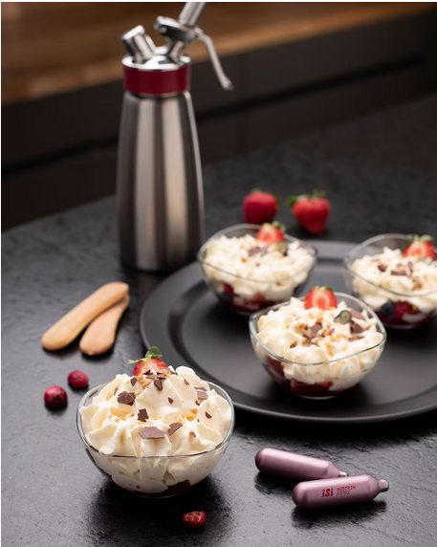
Tiramisu with Berries
preparation
ingredients
1. Prepare the Mousse:
Whisk egg yolks and sugar until pale and thick.
Add mascarpone, vanilla, espresso, liqueur (if using), and salt. Mix until smooth.
Gently fold in heavy cream.
Strain through a fine sieve for a smooth texture.
Pour into a 1-pint iSi siphon, charge with 1 N₂O cartridge, and shake well. Chill for at least 1 hours.
2. Macerate the Berries:
Toss berries with sugar and lemon juice.
Let sit 15–30 minutes to release juices.
3. Assemble:
Place crushed ladyfingers or sponge cake in serving dish. Add a spoonful of macerated berries. Dispense tiramisu mousse from siphon in a rosette or swirl.
8.8 oz mascarpone cheese
6.8 fl oz heavy cream
2 egg yolks
2.1 oz granulated sugar
1 tsp vanilla extract
1 tbsp brewed espresso or strong coffee
1 tbsp coffee liqueur (e.g., Kahlúa, optional)
Pinch of salt
tip
Serve immediately while chilled. Add a drizzle of chocolate or espresso sauce for extra richness.

Slide 22
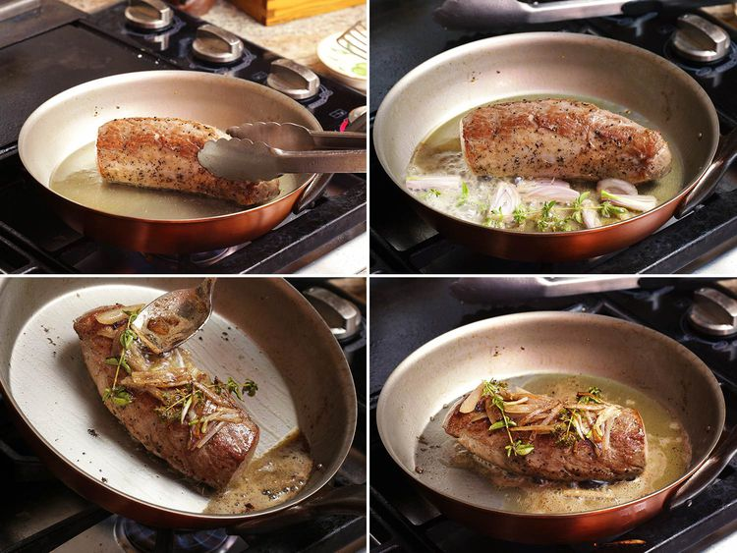
Pork Tender loin
Finishing the Pork
ingredients
Pork tenderloin
z Olive oil
Optional Pan Sauce
1. In the same skillet, add 1 tablespoon of minced shallot and sauté over medium heat until fragrant, about 15 seconds.
2. Deglaze the pan with 1 cup of dry white wine or vermouth, and reduce the liquid by half.
3. Stir in a spoonful of whole grain mustard, the reserved sous vide bag juices, and 1 tablespoon of butter.
4. Swirl the pan gently until the sauce is emulsified. Season to taste with salt and pepper.
tip
For maximum tenderness, slice the pork across the grain into medallions.

Slide 23


THANK YOU
Cesar O. Rivera-Cruzado M.Ed.
Cesar.riveracruzado@ucf.edu
@coriveraucf

