Slide 1
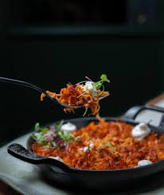
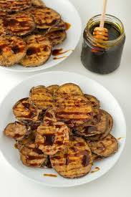
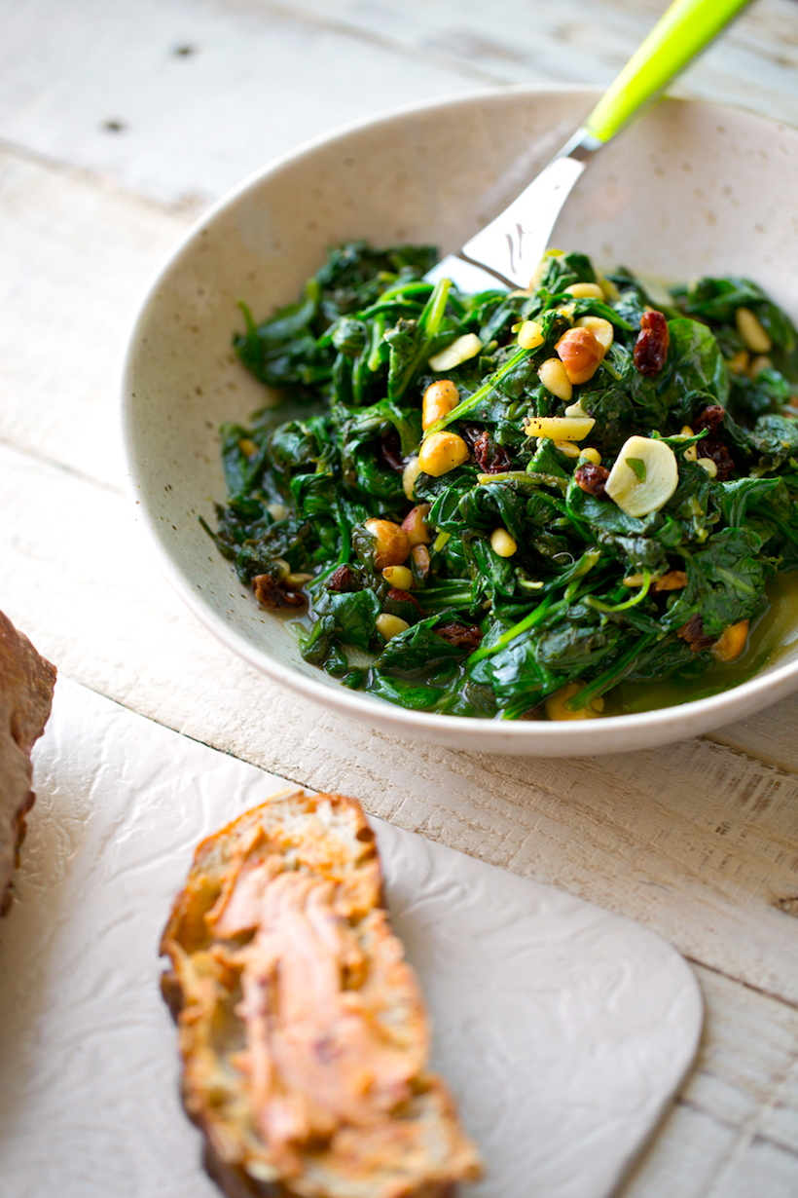
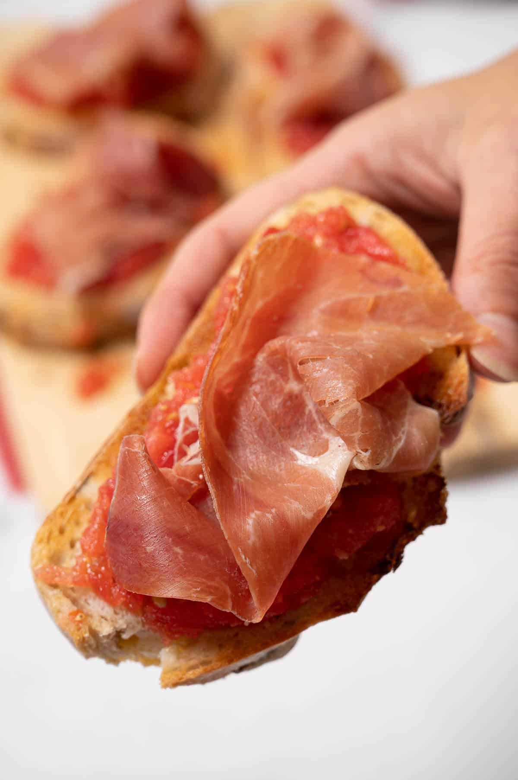

Tapas and the Culinary Traditions of Spain: A Hands-On Exploration
UCF Rosen College
Cesar Rivera-Cruzado M.Ed.

Slide 2
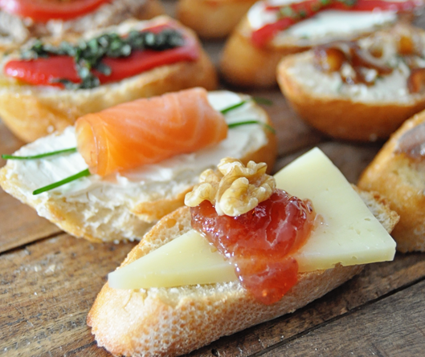

AGENDA
Introduction
Hand-on Experimentation
Pan Con Tomate
Espinacas a la Catalana
Berenjenas fritas con miel
Rosejat

Slide 3
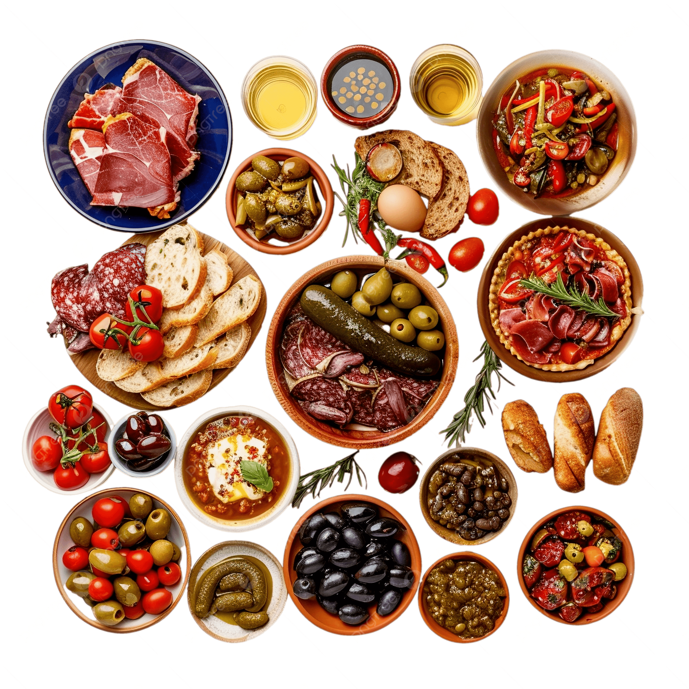
Spanish Tapas Culinary Training
This hands-on culinary course introduces students to the rich world of Spanish tapas, emphasizing their cultural roots, regional diversity, and social dining traditions. Participants will prepare and taste both classic and modern tapas—such as tortilla española, chorizo al vino, and Basque-style pintxos—while exploring their historical and cultural significance. In addition to learning core techniques, students will develop skills in creating and presenting a balanced tapas-style menu. Ideal for culinary students, hospitality professionals, and food enthusiasts, the course promotes creativity, cultural awareness, and an appreciation for Spain's vibrant gastronomic heritage..

Slide 4
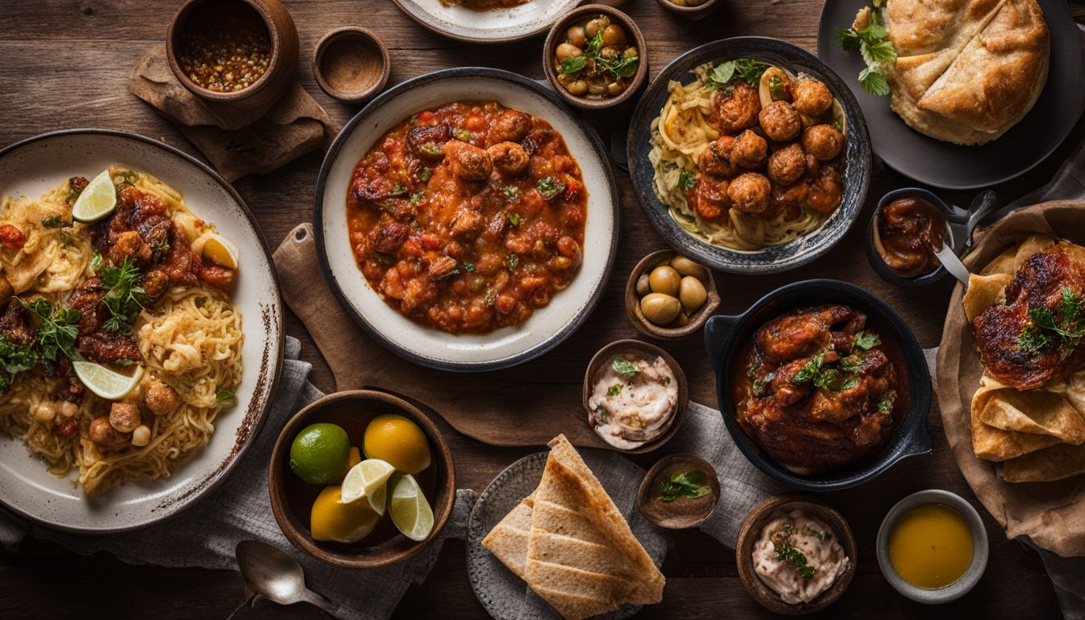
Recipes

Slide 5
Pan con Tomate
ingredients
preparation
2 ripe tomatoes, halved crosswise
4 slices rustic sourdough bread, toasted
Spanish extra-virgin olive oil, for drizzling
Kosher salt
1 Garlic clove
4 thin slices serrano ham
1. Slice a rustic bread such as ciabatta or country loaf into thick pieces.
2. Toast the slices until golden and crisp, either in the oven or in a toaster.
3. Cut ripe tomatoes in half and grate them on the coarse side of a box grater, collecting the pulp in a bowl. Discard the remaining skins.
4. Stir in a generous drizzle of extra virgin olive oil.
5. Season the mixture with sea salt to taste.
6. (Optional) Rub the surface of each toasted slice with a peeled clove of raw garlic for extra flavor.
7. Spoon or spread the tomato mixture generously over the toasted bread.
8. Finish with a touch more sea salt and a final drizzle of olive oil.
9. Serve immediately while the bread is still warm and crisp.
tip
Feel free to customize your Pan con Tomate by pairing it with eggs, cheese, grilled vegetables, anchovies, cured sausage, or any other toppings that suit your taste—make it your own!

Slide 6
Espinacas a la Catalana
ingredients
preparation
2 tbsp Extra virgin Olive oil
1 Golden Apple, peeled cored, and cut into ¼-inch cubes.
¼ cup Pine nuts
¼ cup Raisins seedless
Salt
10 oz Baby spinach
1. Heat the olive oil in a large pot over a high flame.
2. When the oil is very hot, add the apple cubes and cook until they are a little browned, less than 1 minute.
3. Add the pine nuts and cook until they are brown, about 20 seconds. Keep the pot moving so the nuts don't burn.
4. Add the raisins and the ½ teaspoon salt, and stir together.
5. Add the spinach, mix, and sauté very fast until it starts to wilt.
6. Then remove the pot from the heat; the spinach will continue to wilt off the heat.
7. Add salt to taste, and serve immediately.
tip
For extra depth of flavor, lightly toast the pine nuts in a dry pan before adding them to the dish. This enhances their nuttiness and adds a delicious contrast to the sweetness of the raisins and the earthiness of the spinach.

Slide 7
Berenjenas con Miel
ingredients
preparation
1 ½ pound Japanese eggplants, trimmed and cut crosswise on the bias 1/4 inch thick
2 tbsp Kosher salt
2 ½ cup Whole milk
1 cup All-purpose flour
Sea salt, to taste
3 tbsp Honey
Lemon zest, Finely grated (garnish)
1. Place the eggplant in a single layer on a rack set over a large rimmed baking sheet and season with the kosher salt. Top with another baking sheet and press firmly. Let stand for 20 minutes. Press again to help release the juices from the eggplant.
2. Transfer the slices to a large bowl and cover with the milk. Cover and refrigerate for at least 2 hours or overnight.
3. In a large enameled cast-iron casserole, heat 1 inch of oil to 350°.
4. In a shallow bowl, spread the flour. Remove the eggplant from the milk, shaking off any excess liquid. Dredge in the flour and shake off the excess.
5. Working in batches, fry the eggplant, turning a few times, until golden brown, about 3 minutes.
6. Transfer the eggplant to a paper towel–lined baking sheet and immediately season with sea salt.
7. Transfer the eggplant to a serving platter, drizzle with the honey and garnish generously with lemon zest. Sprinkle with more sea salt and serve immediately.
tip
To keep the eggplant slices crispy and prevent them from absorbing too much oil, soak them in salted water for about 30 minutes before frying. This draws out excess moisture and bitterness, resulting in a lighter, crunchier texture.

Slide 8
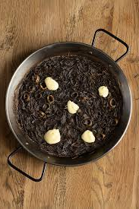
Rossejat
ingredients
preparation
3 tbsp Extra virgin olive oil
24 oz Fideos (angel hair pasta, broken into 1 inch lengths )
1 lb. Shrimp,
8 oz. Cod fillet, diced
3 ea. Tomato, Plum diced
2 ea. Shallots, slice
14 oz Spanish sofrito:(Tomato, onion, garlic, paprika, olive oil)
1 tsp Saffron
24 oz. Stock
2 tbsp Parsley, chop
1. Toast the Pasta: Heat 1 tbsp of oil in a skillet over medium heat. Add the pasta and sauté, stirring often, until golden brown. Transfer to a bowl and wipe out the skillet.
2. Cook the Shrimp: Add 1 tbsp of oil to the skillet. Cook the shrimp in a single layer for 1–2 minutes without stirring, then flip and cook for 30 seconds more until opaque. Set aside and keep warm.
3. Cook the Fish: In the same skillet, cook the fish for 1 minute on one side, then flip and cook for another 30 seconds. Add to the bowl with the shrimp and cover.
4. Build the Base
Add the final 1 tbsp of oil to the skillet. Sauté shallots until soft, then add the tomato and cook briefly until fragrant. Stir in the sofrito, toasted pasta, broth, and saffron. Bring to a boil, then reduce heat and simmer for 3–5 minutes, until most of the liquid is absorbed.
5. Broil: Add the cod to the skillet, then place the pan under the broiler. Broil for 3–5 minutes until the top is crisp and lightly browned.
6. Finish & Serve: Top with the shrimp and their juices. Sprinkle with parsley and serve immediately.
tip
For extra flavor, lightly toast the dry pasta in olive oil until deep golden brown—this step not only adds a rich, nutty taste but also helps the pasta hold its shape better when simmered in broth.

Slide 9
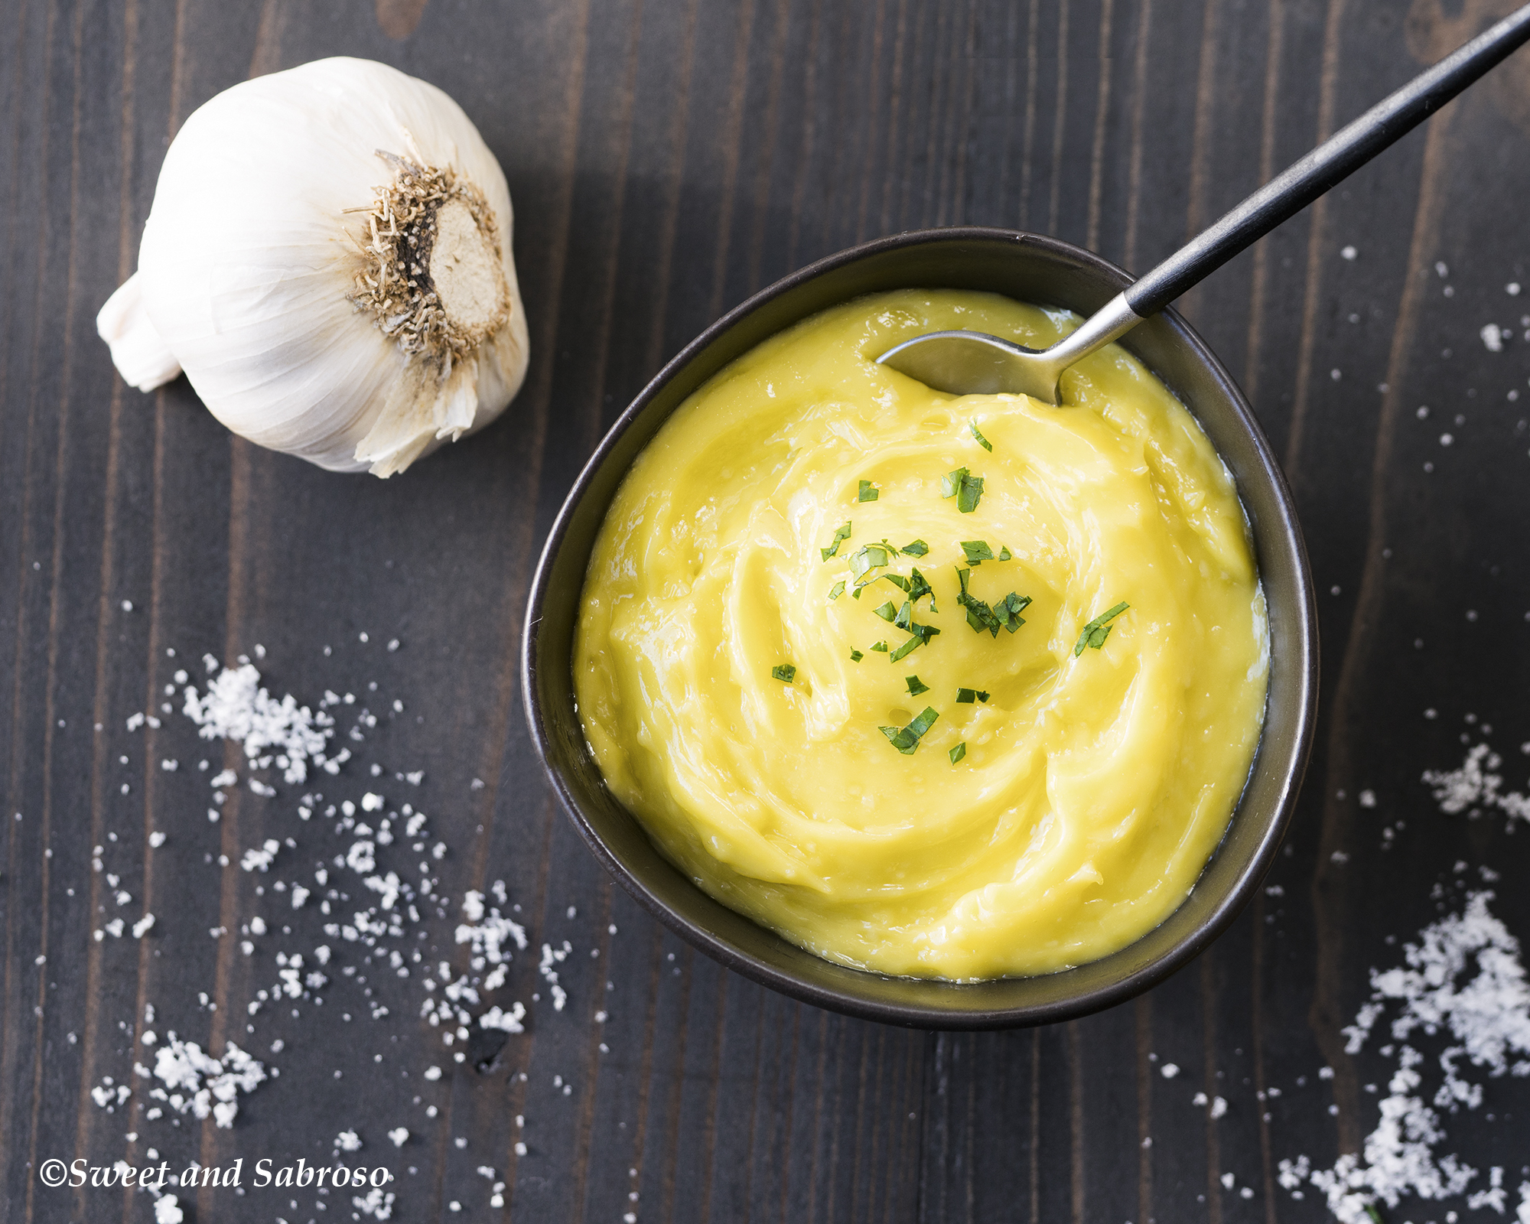
Alliolli
ingredients
preparation
1 ea. Egg
1 cup Olive oil, extra-virgin
1 ea. Garlic clove, peeled
1 tsp Sherry vinegar
Salt
1. Add the garlic, egg yolk, lemon juice, and a pinch of salt to the Vitamix.
2. Blend on low speed until the garlic is finely chopped.
3. While blending, very slowly drizzle in the oil through the lid plug opening. This slow addition is key to forming a stable emulsion.
4. Once all the oil is added and the mixture thickens, taste and adjust salt or lemon juice as needed.
.
tip
For a smooth and stable allioli, make sure all your ingredients—especially the egg (if using) and oil—are at room temperature. This helps the emulsion form more easily and prevents it from splitting.

Slide 10


THANK YOU
Cesar O. Rivera-Cruzado M.Ed.
Cesar.riveracruzado@ucf.edu
@coriveraucf

