Slide 1
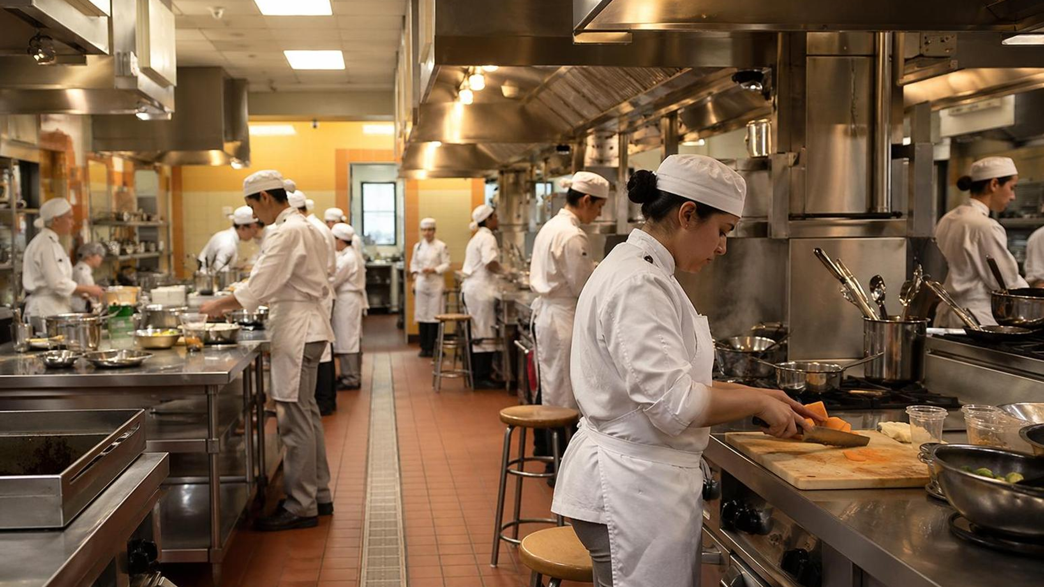

Brain-Based Teaching for Culinary Education
Practical Strategies for Attention, Memory, Feedback, and Skill Transfer
Presented by:
Dr. Colin Roche, CEC, CCE, FMP, CHE

Slide 2
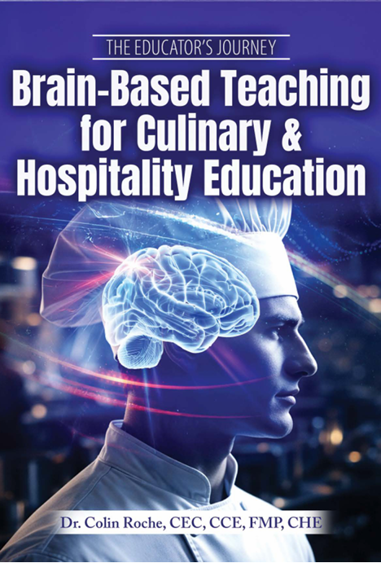
About the Book
Use the book to explore and go deeper into:
Brain-based teaching principles
Culinary classroom applications
Lab-based strategies
Practical examples
Reflection and planning tools
Today is the appetizer.
The book is the full menu.

Slide 3
Where We Are Going
Why culinary students forget or get overloaded
Brain-based principles that explain it
Lab-ready strategies to reduce overload and improve retention
Practice applying one strategy
Commit to one change and connect to this presentation

Slide 4
Today’s Big Question – Why does this matter in Culinary Arts?
Culinary Students need to:
Understand concepts
Work safely
Use tools correctly
Collaborate under pressure
Manage time
Remember and transfer skills
Perform in real time under pressure
Follow procedures
They are not just learning information. They are learning performance.
Culinary learning is brain-based learning in action!

Slide 5

Turn & Talk — 60 Seconds (Activity 1, Handout Page 3)
What is one thing students often:
Forget?
Miss during demonstrations?
Struggle to transfer into lab performance?
Be ready to share one example!

Slide 6
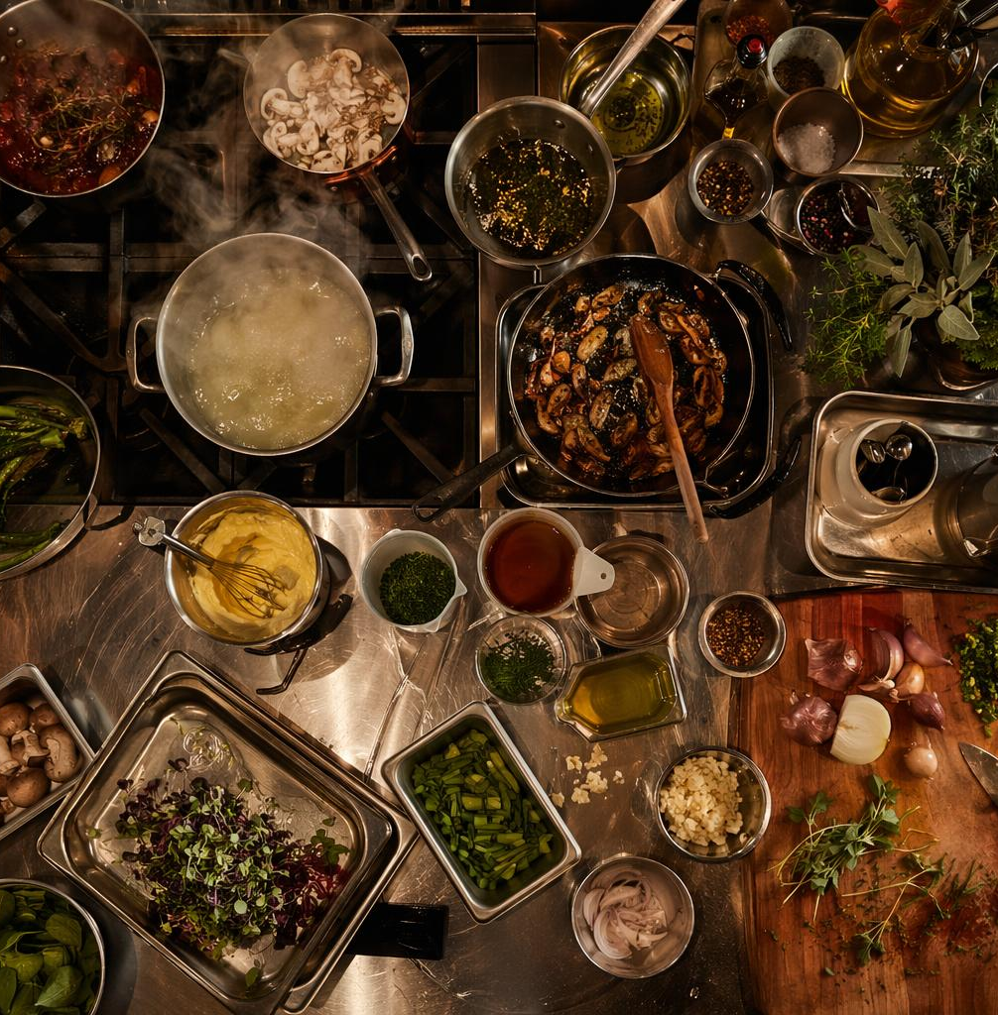
In a culinary lab, students must manage:
Attention
Working memory
Sensory input
Motor skills
Timing
Safety
Teamwork & Communication
Problem-solving
Emotions & Pressure
The Culinary Brain Is Busy
That is a lot of brainwork!

Slide 7

What Is Brain-Based Teaching?
Brain-based teaching means designing instruction around how people learn!
It looks at:
Attention
Memory
Emotion
Motivation
Practice
Feedback
Transfer

Slide 8

Brain-Based Teaching: What It Is Not
Brain-based teaching is not:
Learning styles
Left brain/right brain labels
Neuroscience jargon
A magic trick
A replacement for good teaching
It is intentional & practical instructional design

Slide 9
Today’s Principles and Strategies
Principle 1: Attention is Key
Strategy: Capture, Focus, Reset
Principle 2: Working Memory is Limited
Strategy: Chunk the Demo
Principle 3: Reduce Cognitive Load
Strategy: Do a Cognitive Load Audit
Principle 4: Emotion Shapes Learning
Strategy: Lower Threat, Raise Challenge
Principle 5: Motivation Comes From Relevance
Strategy: Make the “Why” Visible
Principle 6: Retrieval Strengthens Memory
Strategy: The 2-minute Retrieval Warm-Up
Principle 7: Spaced Practice Beats Cramming & Builds Transfer
Strategy: Spiral Culinary Skills
Principle 8: Feedback Drives Skill Growth
Strategy: Feedback During Labs, Not Just After

Slide 10
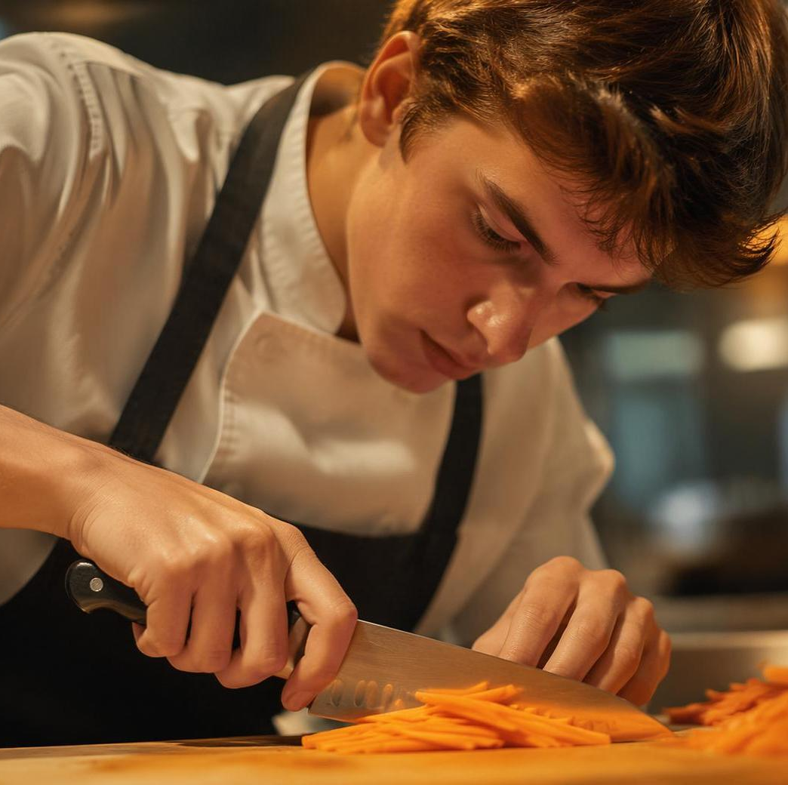
Principle 1: Attention Is the Gateway
Students cannot learn what their brains do not notice. Attention is shaped and influenced by:
Relevance
Novelty
Emotion
Movement
Purpose
Reduced distraction
No attention = No learning

Slide 11

Strategy: Capture, Focus, Reset (Activity 2, Handout page 8)
Capture: Start with something students notice.
Focus: Tell them exactly what to watch or listen for.
Reset: Pause and refocus before transitions.
Example: "Watch my guide hand. In 20 seconds, I’ll ask what you noticed."
ACTIVITY: Where in your lab could a 30-second focus cue prevent mistakes?

Slide 12
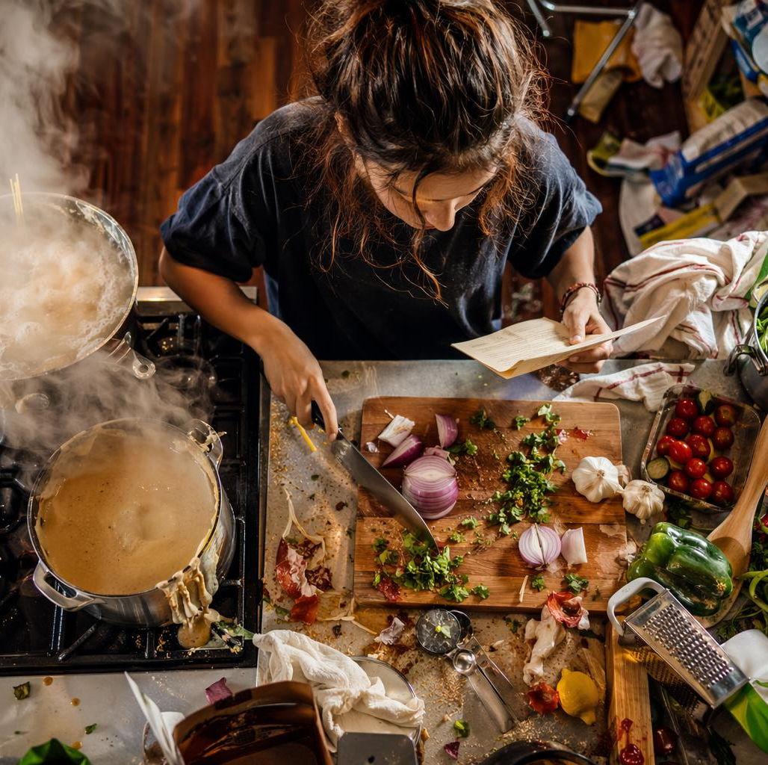
Principle 2: Working Memory Is Limited
Working memory is the brain’s temporary workspace. It can overload quickly when students juggle too much or must remember too much, such as:
Multi-step Directions
New Vocabulary
Tools and their use
Measurements
Timing
Safety/Rules
Team or Group Roles
The brain needs mise en place, too.

Slide 13
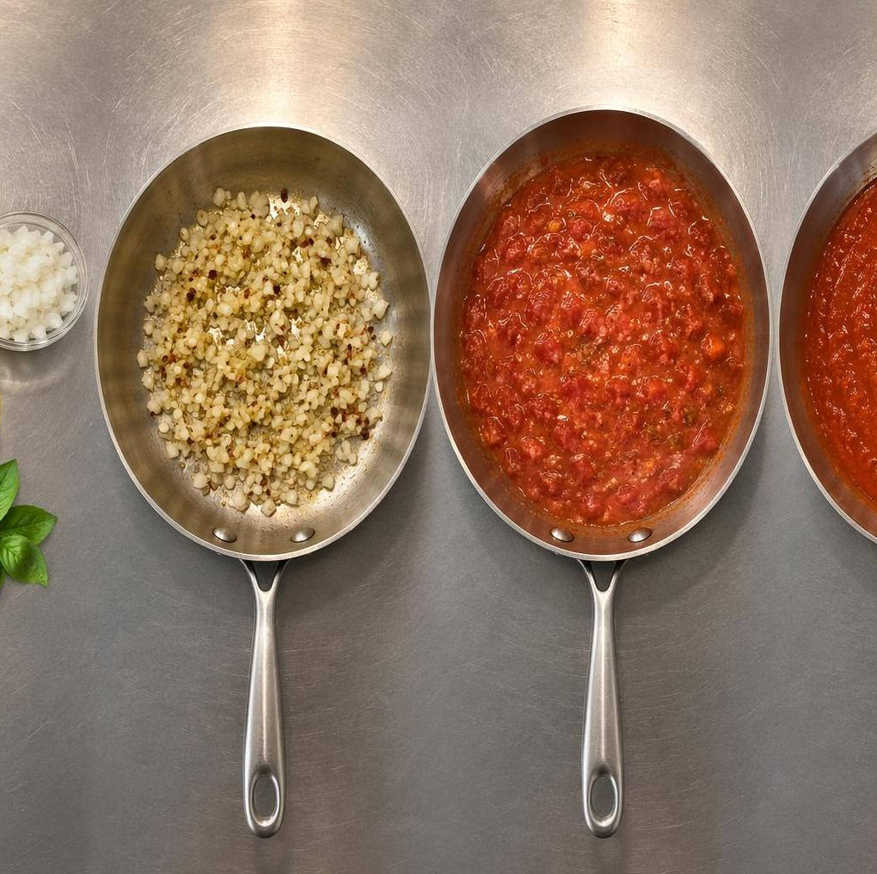
Strategy: Chunk the Demo
Instead of one long demonstration:
1. Show the whole skill briefly
2. Break it into parts or chunks
3. Name the key cue
4. Let students practice
5. Add the next layer
Demo less. Practice sooner.

Slide 14
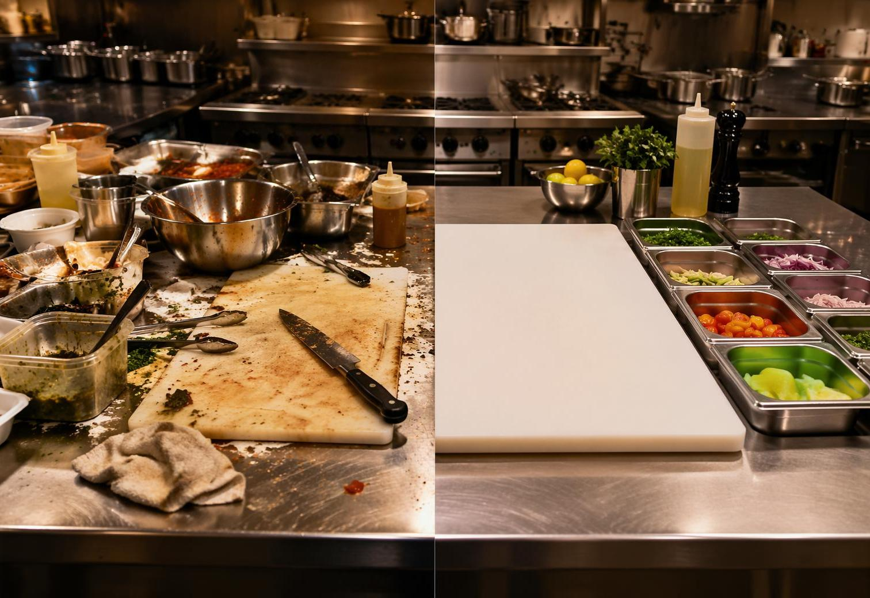
Principle 3: Reduce Cognitive Load
Cognitive Load = the mental effort required to complete a task.
Students become overloaded when they must manage too much at once.
Reduce load by:
Clarifying steps
Removing distractions
Pre-teaching vocabulary
Modeling one skill at a time
Using visual cues
Simplifying first attempts

Slide 15

Strategy: Cognitive Load Audit
Small Group Activity (3 minutes):
Choose one common task:
Knife cuts
Following a recipe
Baking measurement
Sanitation procedure
Sautéing
Mise en place
Lab cleanup
Discuss:
1. Where do students get overloaded?
2. What could you remove, clarify, model, or chunk?
Reduce Cognitive Load by Making Learning Visible
(Activity 3, Handout page 9)
Think of one lab you teach.
What is one thing students currently have to hold in memory?
How could you make it visible?

Slide 16

Principle 4: Emotion Shapes Learning
Emotion affects:
Attention
Memory
Confidence
Risk-taking
Persistence
Response to feedback
Students remember experiences that feel meaningful, stressful, successful, embarrassing, or relevant.

Slide 17
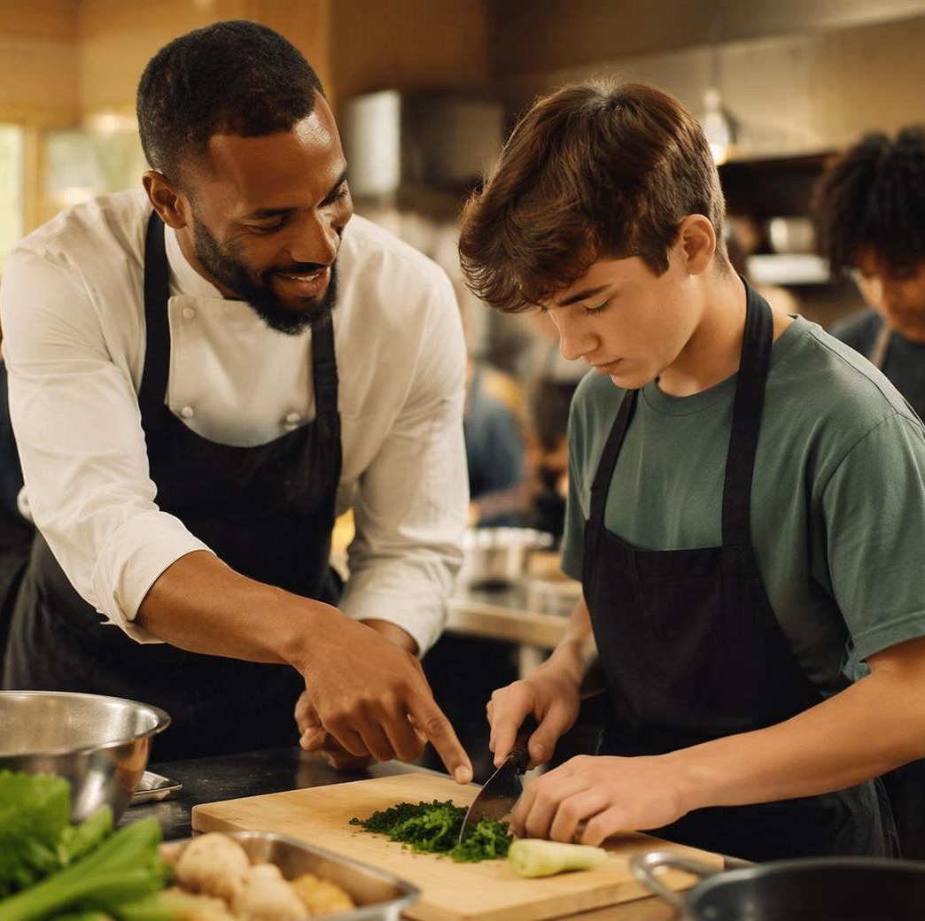
Strategy: Lower Threat, Raise Challenge
Brain-based labs should be safe enough to try and challenging enough to matter!
Try:
Normalize mistakes
Preview common errors
Use practice rounds
Give clear success criteria
Celebrate improvement
Correct without embarrassing

Slide 18

Principle 5: Motivation Comes From Relevance
Students engage more when they understand:
Why this matters
Where will they use it
How it connects to identity
How it builds or supports independence
How it relates to careers
How it helps them create something meaningful
Make The “WHY” Visible!

Slide 19
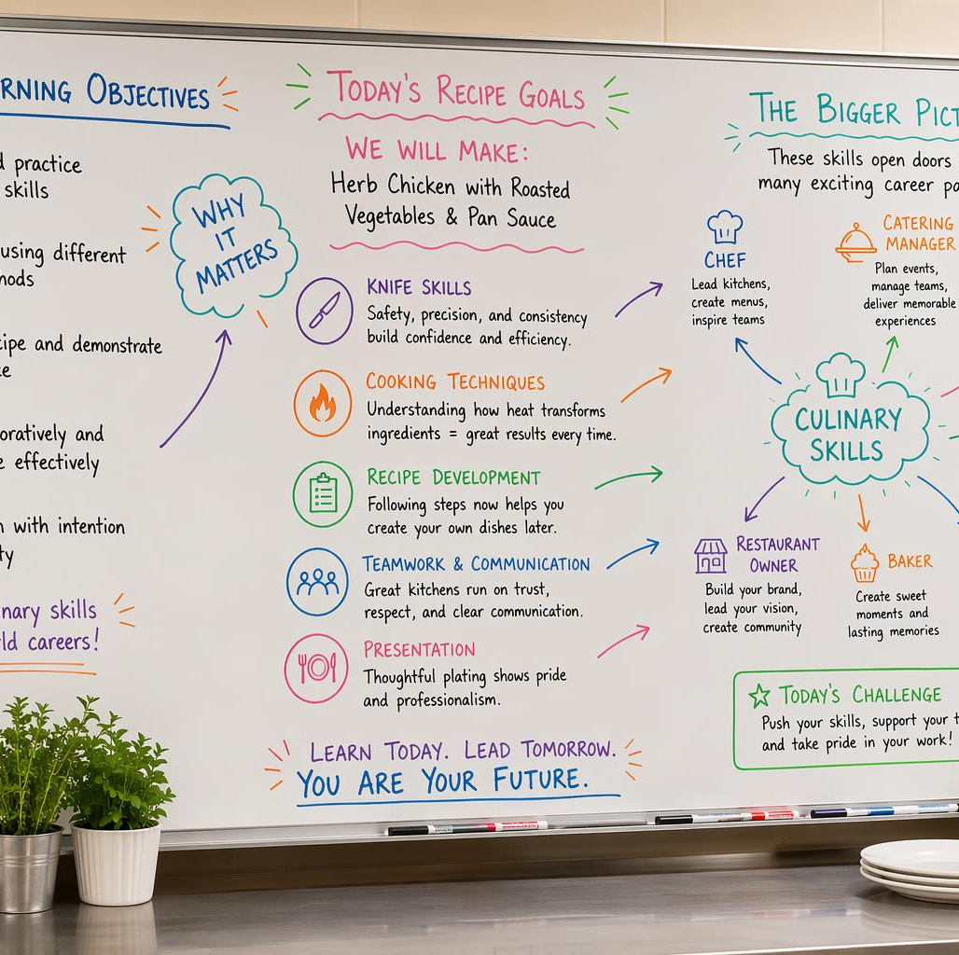
Strategy: Make the “Why” Visible
Common Instruction | Add The “Why”
Keep your station clean. | A clean station reduces cross-contamination and helps you work faster.
Keep knife cuts consistent. | Consistent cuts cook evenly and plate professionally.
Taste as you go. | Tasting helps you adjust seasoning before the final plate.
Common Instruction | Add The “Why”
Keep your station clean.
Keep knife cuts consistent.
Taste as you go.
Before teaching a skill, connect it to:
Professional standards
Real kitchen consequences
Student independence
Creativity
Culture and identity
Customer experience
Prompt: Where will this skill show up outside this classroom?

Slide 20

Principle 6: Retrieval Strengthens Memory
Students remember more when they practice retrieving information.
Examples:
List three sanitation steps.
What is the first thing you do before cutting?
What temperature danger zone should be avoided?
What did you learn from the last lab?
Retrieval is stronger than rereading.

Slide 21

Strategy: Start with a 2-Minute Retrieval Warm-Up
No-tech retrieval warm-up options:
Brain dump
Partner quiz
Finish the sequence
Spot the error
Three things from last lab
Safety check
Vocabulary recall
Make students retrieve before they perform.

Slide 22
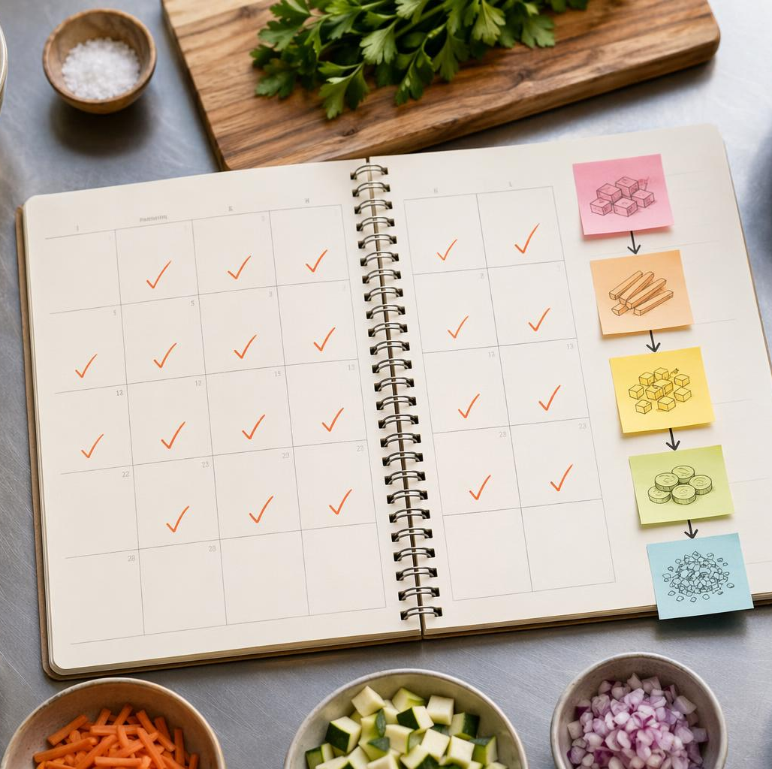
Principle 7: Spaced Practice Beats Cramming
& Builds Transfer
Students retain skills better when practice is spread out over time.
Instead of:
Teach once → Test once → Move on
Use:
Introduce → Practice → Revisit → Apply → Transfer

Slide 23
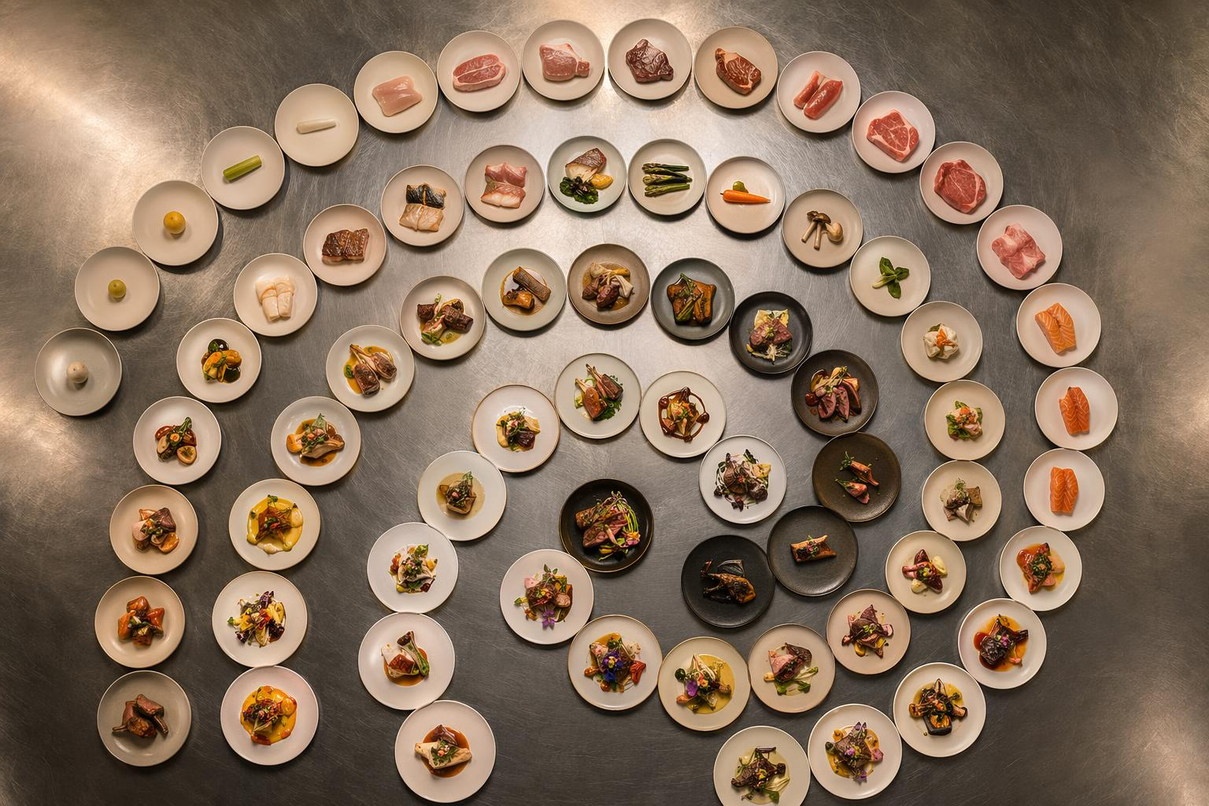
Strategy: Spiral Culinary Skills (Activity 5, Handbook page 11)
Build recurring skill routines by revisiting core skills across recipes and units:
Knife skills across multiple recipes
Sanitation in every lab
Measurement in cooking and baking
Mise en place before every production task
Tasting vocabulary throughout the course
Team communication
Lab reflection
Key skill | First exposure | Second exposure | Later transfer
Knife cuts
Heat control
Seasoning
Sanitation
Key skill | First exposure | Second exposure | Later transfer
Knife cuts | Knife skills lab | Soup prep | Garde manger production
Heat control | Egg cookery | Sauces | Sauté station
Seasoning | Stocks | Soups | Final practical
Sanitation | Orientation | Every lab station check | Capstone service
Repetition with variation builds transfer.

Slide 24
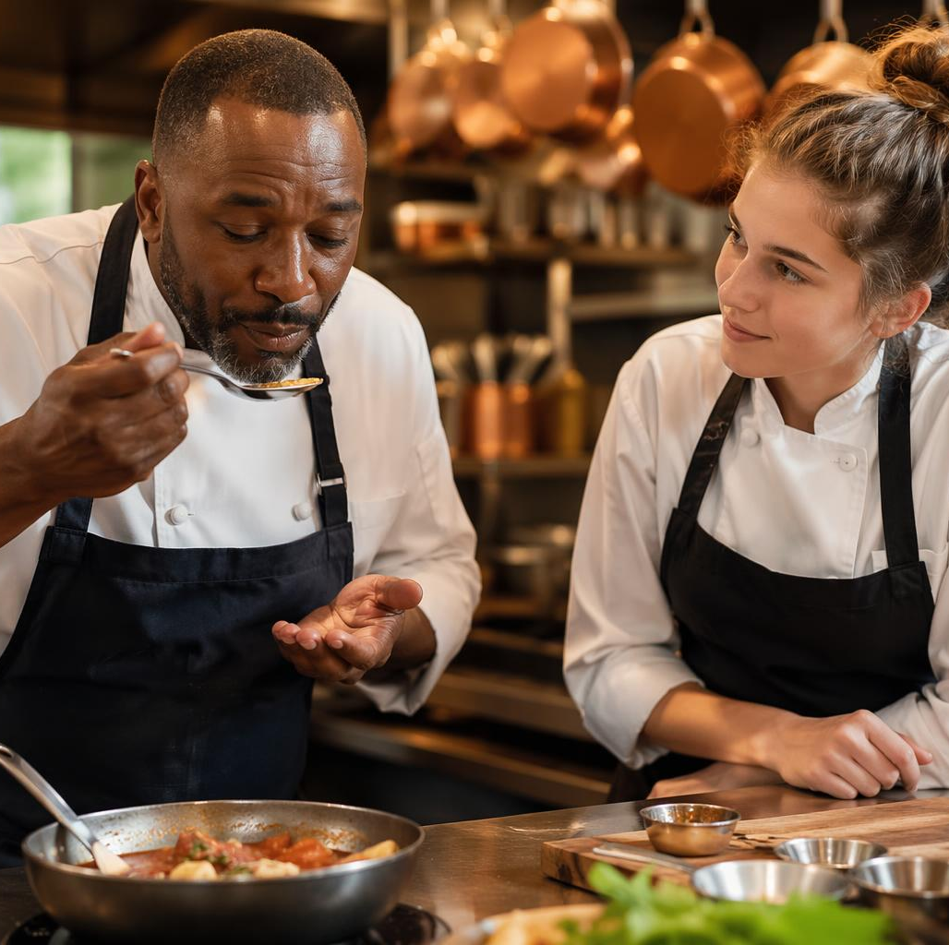
Principle 8: Feedback Drives Skill Growth
Effective feedback is:
Timely
Specific
Actionable
Focused
Connected to success criteria
Less helpful: Good job; Be careful; Do better.
More helpful: Curl your guide fingers and keep the knife tip in contact with the board.
Less Helpful | More Helpful
Good job. | Your cuts are consistent in width. Keep that.
Be careful. | Move your towel away from the cutting board for safety.
Do better. | Slow down and keep the knife tip in contact with the board.

Slide 25
REWRITE THE FEEDBACK (Activity 6)
Turn these into specific, actionable feedback!
Activity format
1-minute individual rewrite
2-minute pair discussion
2-minute report out
Be careful - “Curl your guide fingers and keep the knife tip on the board.”
That cut is wrong - “Trim the pieces to the same width so they cook evenly.”
Your station is messy - “Move the sanitizer bucket to the front and clear scraps from the board.”
You need to work faster - “Group your tools by task before you start the next step.”
“Be careful.”
“That cut is wrong.”
“Your station is messy.”
“You need to work faster.”

Slide 26
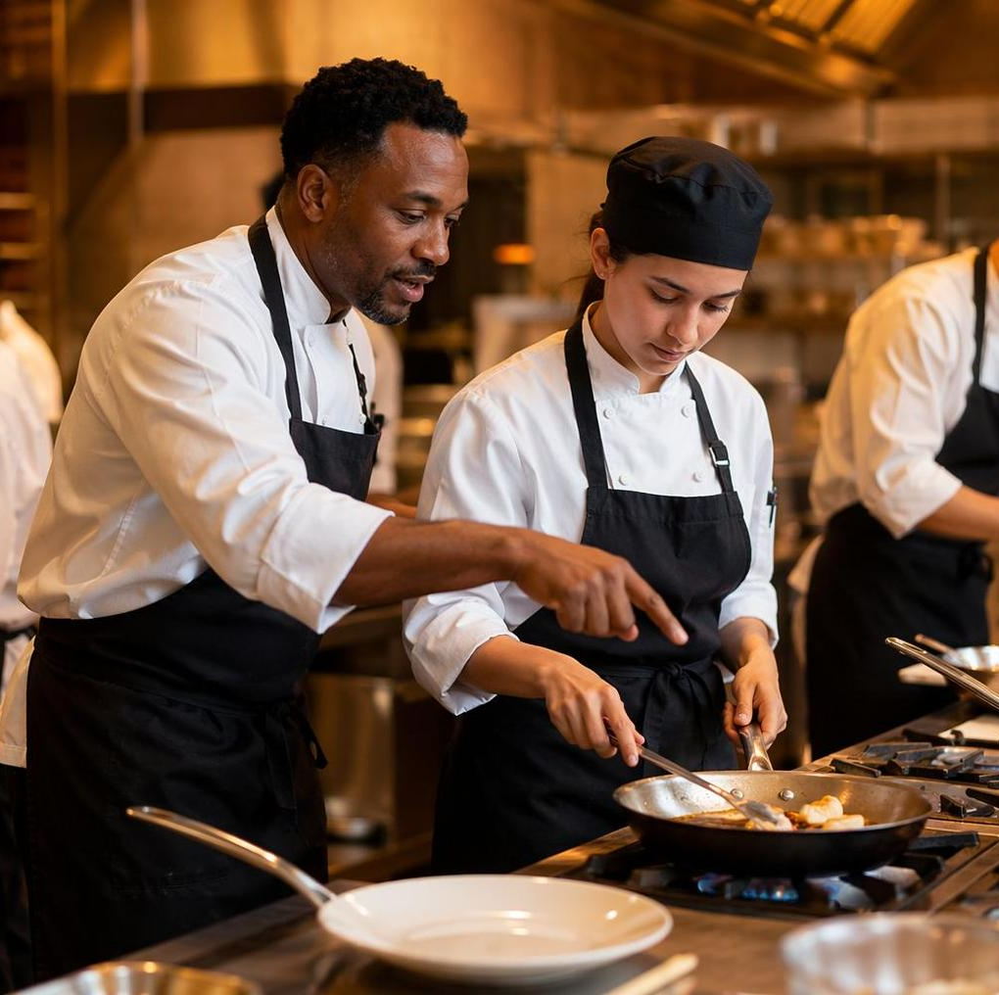
Strategy: Feedback During the Lab, Not Just After
Use brief coaching cues:
Name what you see
Give one adjustment
Have students try again
Ask them to self-assess
Example: I see your station is organized by task. Now move your towel away from the cutting board for safety. Try the setup again; what changed?

Slide 27
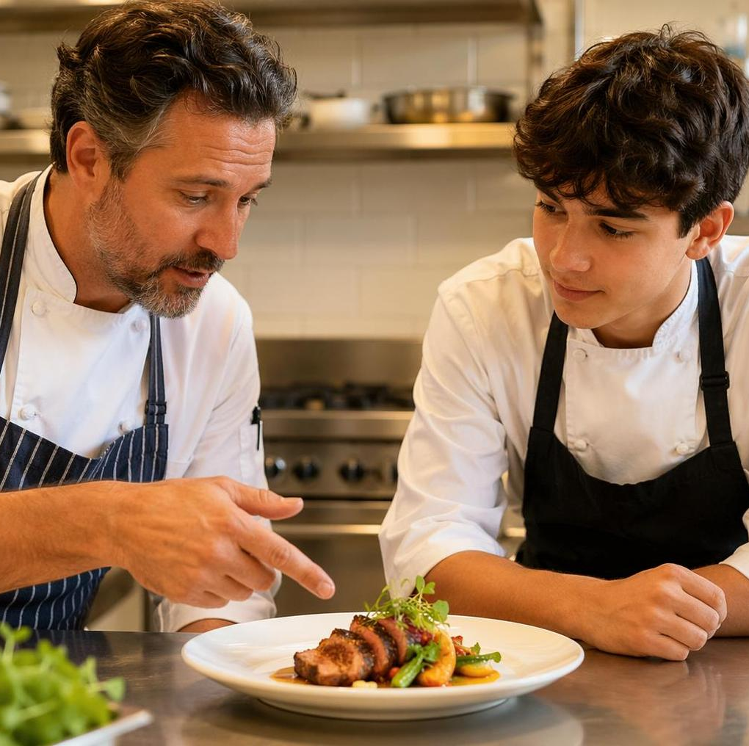
Defining Constructive Criticism & Its Importance
Constructive Criticism is feedback that helps individuals recognize areas for improvement and guide them in enhancing their performance.
Constructive Criticism is
specific, actionable, and supportive.
Constructive Criticism plays a crucial role in effective learning and personal growth by fostering an environment where mistakes are viewed as opportunities for development rather than failures.

Slide 28
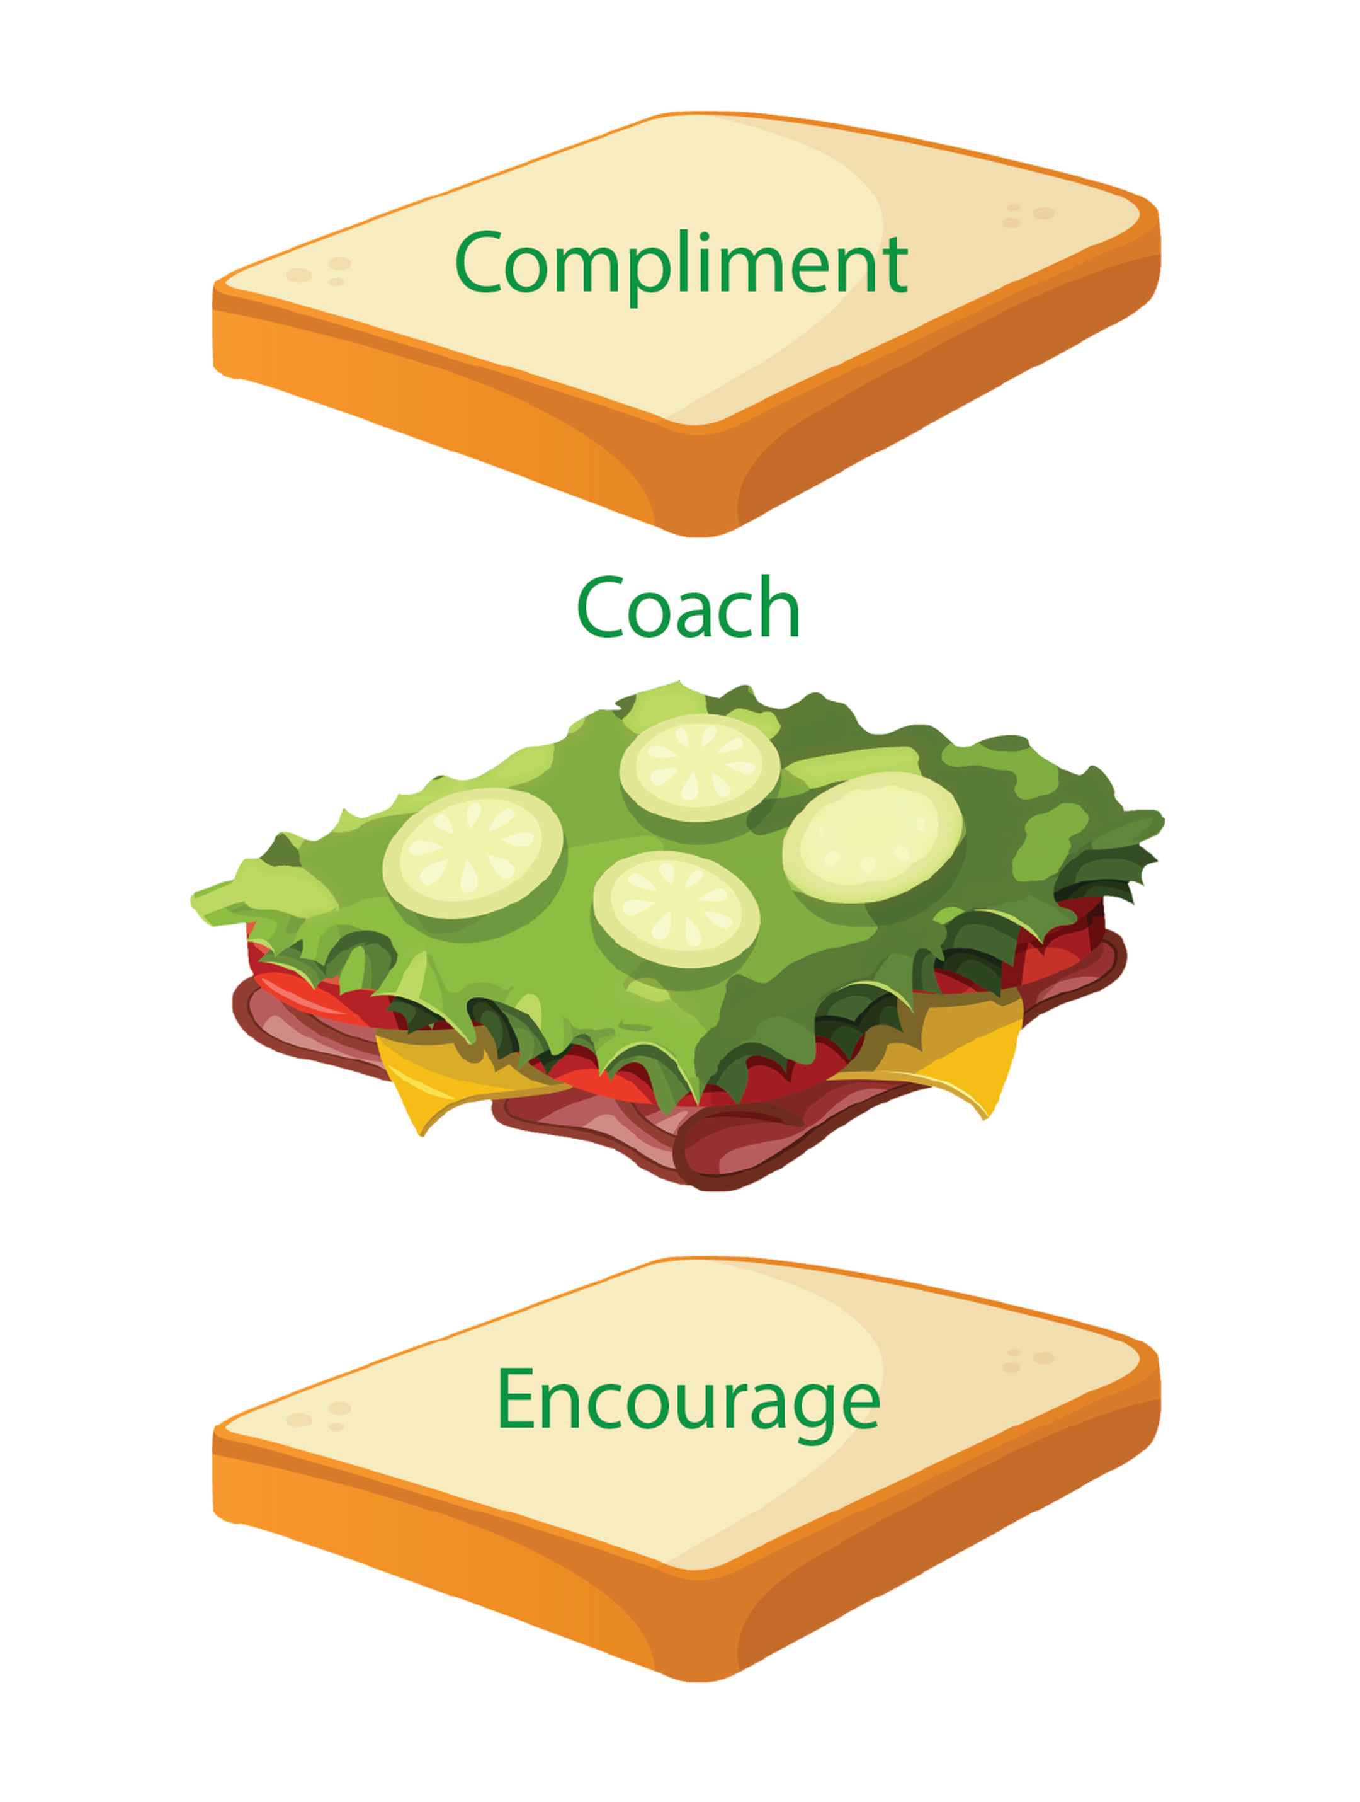

The Neuroscience of Receiving Feedback
The amygdala is the brain structure that processes emotions, particularly fear and threat responses!
Emotional Responses – Feelings of anxiety, defensiveness, or embarrassment
Fight, flight, or freeze reaction
Feedback (compliment) sandwich
Clear, specific, and behavior-focused
Open dialogue and active listening

Slide 29
Putting It Together: The Brain-Based Culinary Lab
Before Lab | During Lab | After Lab
Capture Attention | Reduce Overload & Chunk the demo | Retrieve Learning
Reduce Cognitive Load & Chunk Directions | Use Cues and Check-ins | Reflect on Errors
Clarify Purpose & Make the “why” Visible | Reset Attention & Normalize Correction | Plan Transfer
Activate Prior Knowledge | Coach in the Moment | Connect to Next Time

Slide 30
Example: Redesigning a Culinary Lab
Traditional Approach:
“Today we are making chicken stock. Watch the demo, then complete the lab.”
Brain-based Approach:
Before: 2-minute retrieval warm-up: “What are the four qualities of a good stock?”
During: Demo is chunked into bones, aromatics, simmering, skimming, and straining
During: Instructor uses one feedback cue: “Clear broth, gentle bubbles.”
After: Exit prompt: “What is one mistake that would make a stock cloudy?”

Slide 31
Brain-Based Teaching Does Not Require Rebuilding Your Course
Key Points:
Start with one 2-minute routine.
Replace, don’t add.
Use existing demos, recipes, and lab expectations.
Focus on the moments where students commonly forget, overload, or repeat mistakes.
This approach is manageable.

Slide 32
If your students… | Try this strategy
Forget steps during lab | Chunk the demo
Start unfocused | Capture, Focus, Reset
Repeat the same mistakes | 2-minute retrieval warm-up
Don’t understand purpose | Make the why visible
Get overwhelmed by instructions | Cognitive load audit
Struggle to transfer feedback | In-the-moment feedback cue
Lose skills over time | Spiral a key skill
Notes:
?

Slide 33
Choose one upcoming lesson or lab.
Complete the planning frame:
My lab/topic is: __________
Students often struggle with: __________
I will use this strategy: __________
I will use it before/during/after lab: __________
Students should be able to: __________
Reflect on your one change!
Apply It to Your Next Lesson or Lab
(Activity 7, Page 13)
Capture, Focus, Reset
Chunk the demo
Cognitive load audit
Lower Threat, Raise Challenge
Make the “why” visible
2-minute retrieval warm-up
Spiral key culinary skills
Feedback during lab

Slide 34

Your One Change
In my next culinary lesson/lab, I will use _____ before/during/after ________ so that students can __________.
Example: In my next culinary lab, I will use a 2-minute retrieval warm-up before knife skills practice so that students can recall safety and precision expectations before they begin cutting.
Think-Pair-Share
What is your first step for using this strategy?
How will you know if this strategy helped your students?

Slide 35
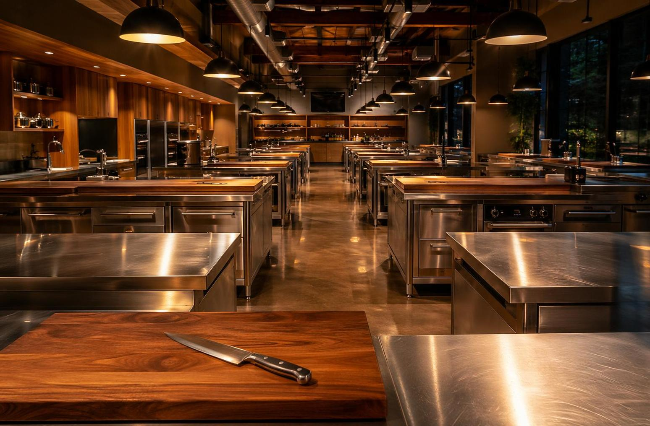
One Change. One Lab.
Before students cook, help them remember.
During lab, help them focus and adjust.
After the lab, help them transfer.
THANK YOU

