Slide 1

navigating the ethics of culinary leadership
Dr. Raymond Baker
Assistant Professor/Program Director
St. Thomas University

Slide 2
Leadership Quote
"You won't find ethical leadership in the rule book. It's in the deep commitment to good that drives our choices and transforms our organizations."
-Linda Fisher Thornton

Slide 3
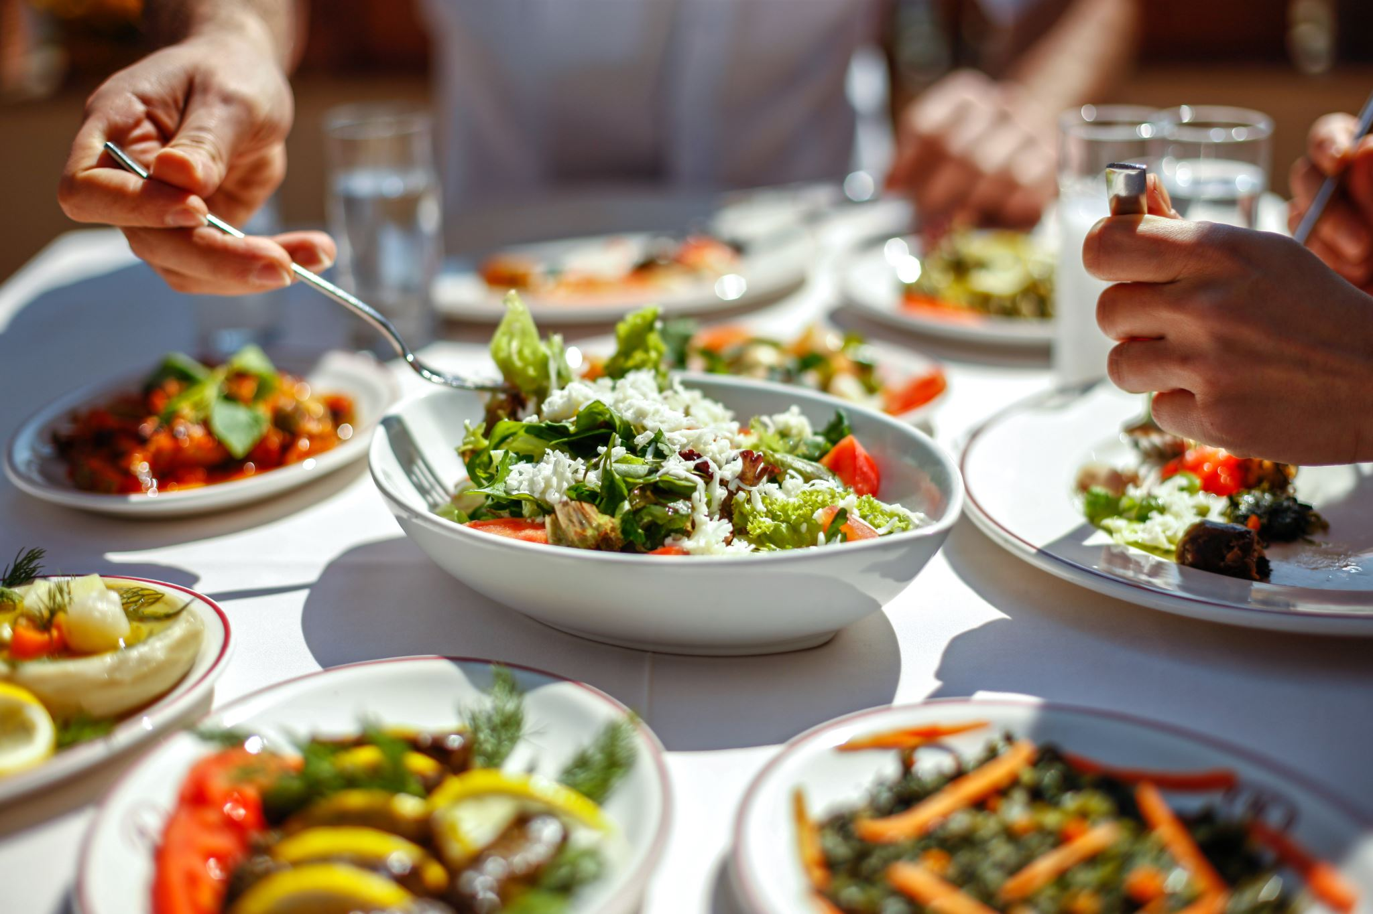
Introduction to Ethical Leadership
Ethical Leadership is characterized by the demonstration and promotion of “normatively appropriate conduct through personal actions and interpersonal relations” (Brown et al., 2005, p. 120). It is foundational for ethical decision-making.
Ethical leadership is essential for establishing trust with customers, creating a positive work environment, and building a reputable business.

Slide 4

Principles of Ethical Leadership
Respect
Service
Fairness
Honesty
Community

Slide 5

Ethical Dilemmas
Accepting Gifts
Taking items home
Samples
Membership dues
Sanitation

Slide 6
Building Trust and Respect
Transparency: Practice open communication with employees, customers, and suppliers to build trust and transparency
Fair Treatment: Ensure fairness in all aspects of the business, including hiring, promotions, and compensation, to cultivate a culture of respect
Accountability: Hold oneself and others accountable for their actions and decisions, fostering trust and reliability

Slide 7
Fostering a Positive Work Culture
Respectful Environment: Create a workplace culture that welcomes diverse perspectives and values mutual respect among team members
Professional Development: Invest in employee training and development opportunities to foster growth and advancement
Work-Life Balance: Promote a healthy work-life balance to prevent burnout and support overall well-being among staff

Slide 8
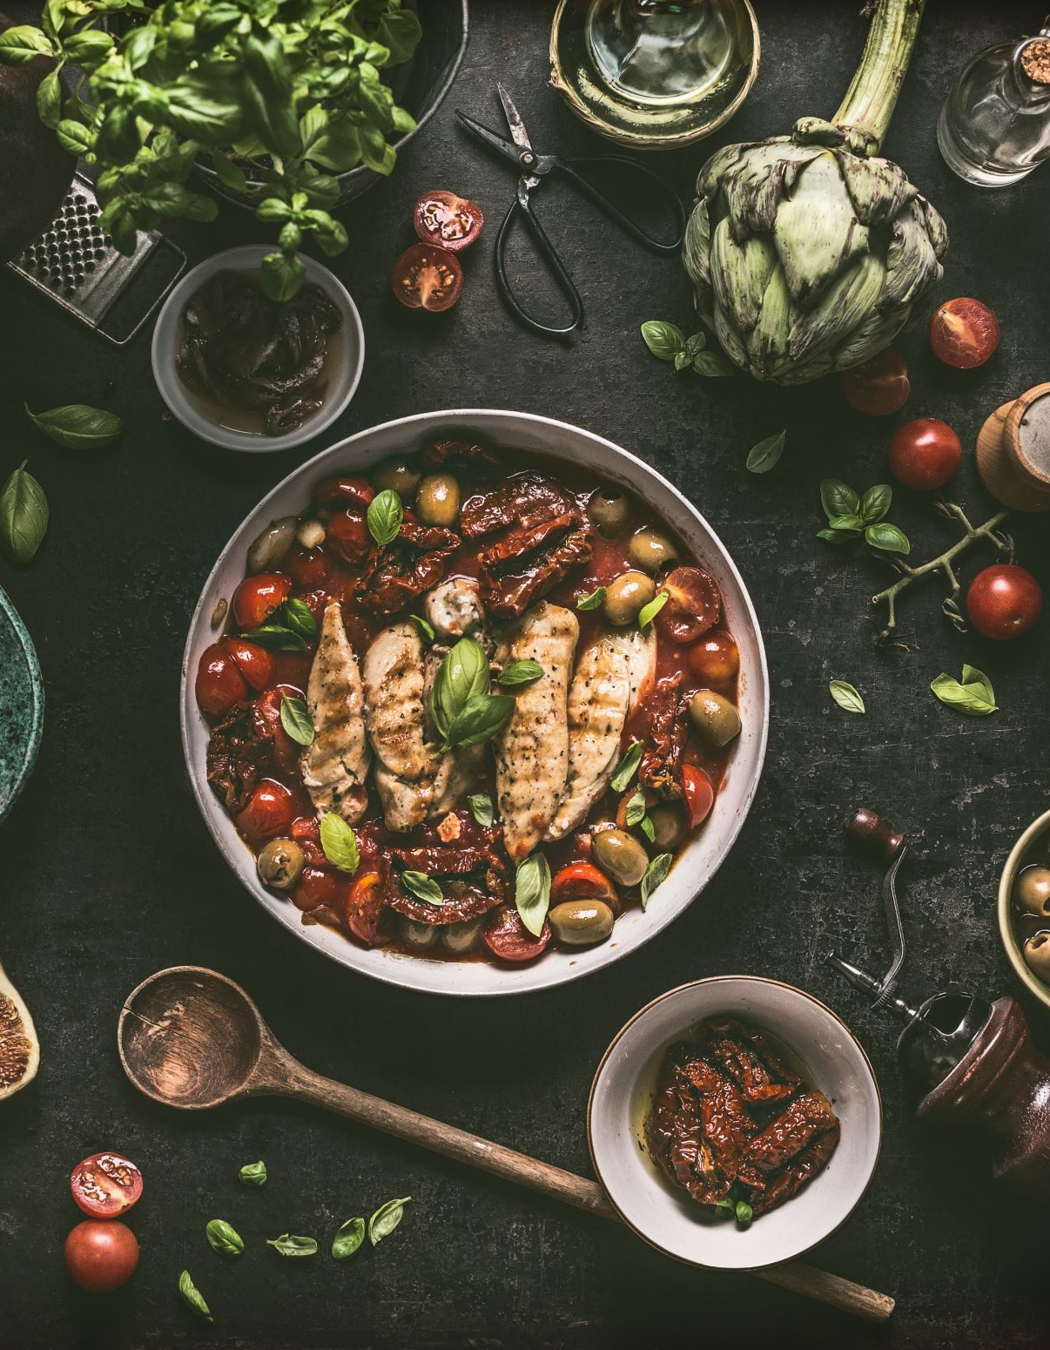
Upholding Quality and Integrity
Quality: Ensure the authenticity and quality of ingredients used in recipes, maintaining the integrity of the culinary creations
Integrity: Provide accurate and transparent descriptions of dishes on menus, avoiding exaggeration or misrepresentation
Compliance: Ensure adherence with laws and regulations governing food safety, labor practices, and environmental sustainability

Slide 9

Ethical Marketing and Communication
Transparency in Advertising: Provide honest and transparent information in marketing materials, avoiding misleading claims or false advertising
Ethical Branding: Align your branding with your values and principles to build trust and loyalty among customers
Social Responsibility: Engage in philanthropic activities and community outreach to contribute positively to society and demonstrate corporate social responsibility

Slide 10
Case Study
Chef Maria owns a renowned fine dining restaurant that prides itself on using locally sourced, organic ingredients. One day, she discovers that one of her primary suppliers, a local farm, has been accused of violating labor laws and mistreating its workers. The farm provides high-quality produce at a competitive price, and Chef Maria has developed a strong professional relationship with the farm's owner over the years.

Slide 11
Conclusion
Ethical leadership is essential for chefs and the industry as whole to build trust, foster a positive work culture, and contribute to sustainability.
Prioritize ethical decision-making in your culinary practice to create a lasting impact on your businesses and communities.

